Slide 1
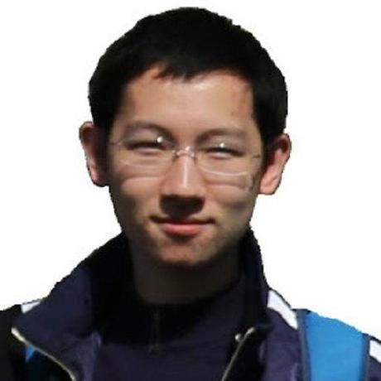
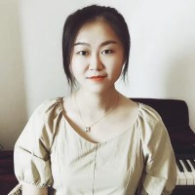





CLOUD: Contrastive Learning of Unsupervised Dynamics
Jianren Wang*¹, Yujie Lu*², Hang Zhao³
³IIIS, Tsinghua
¹CMU RI
²Tencent
*Equal Contribution
Notes:
Hello Everyone, I am Jianren Wang from CMU. Today I am going to talk about “CLOUD: Contrastive Learning of Unsupervised Dynamics
”. This is joint work with Yujie Lu, Hang Zhao

Slide 2

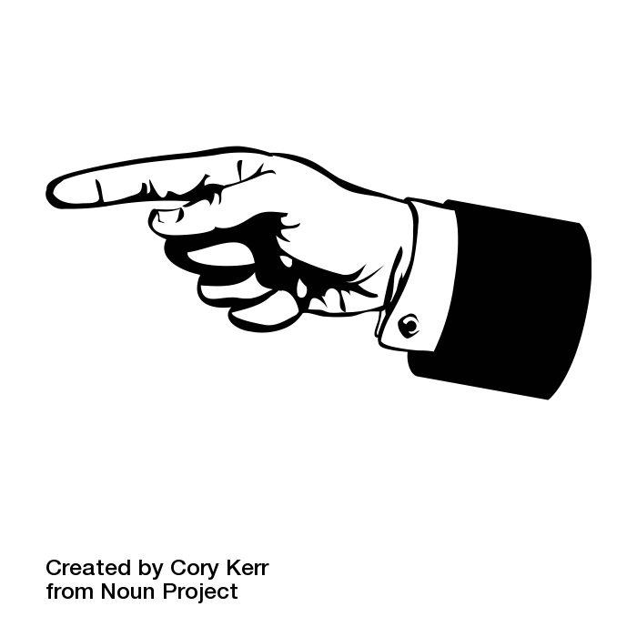
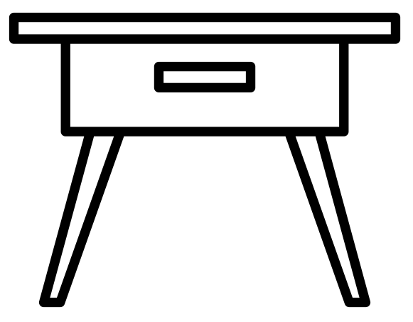
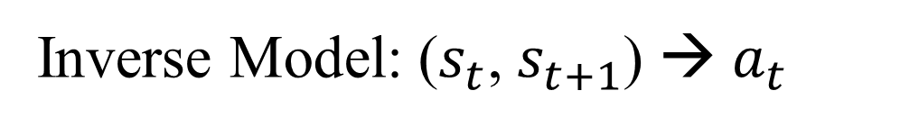
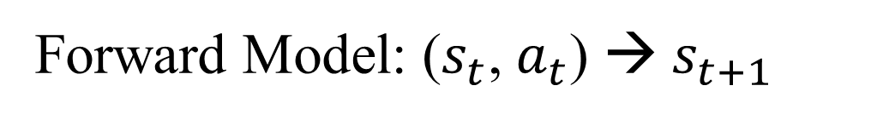
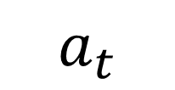
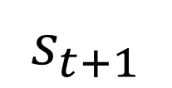
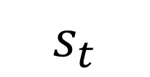
Task: Modeling Dynamics
$$a_{t}$$
$$s_{t}$$
$$s_{t+1}$$
Forward Model: ($s_{t}$, $a_{t}$) → $s_{t+1}$
Inverse Model: ($s_{t}$, $s_{t+1}$) → $a_{t}$
Notes:
In this work, we focus on the problem of modeling dynamics in the physical world, which is an essential and fundamental problem in the robotics applications, such as manipulation, planning, and model-based reinforcement learning.
Given a state-action-state tuple, the goal of forward model is to predict the next state from the current state and action, and the goal of inverse model is to predicts the action given the initial and target states.
To perform complex control tasks in an unknown environment, an agent needs to learn these models from experience. However, developing agents that can learn dynamics directly from high dimensional observations such as pixels is known to be challenging.

Slide 3
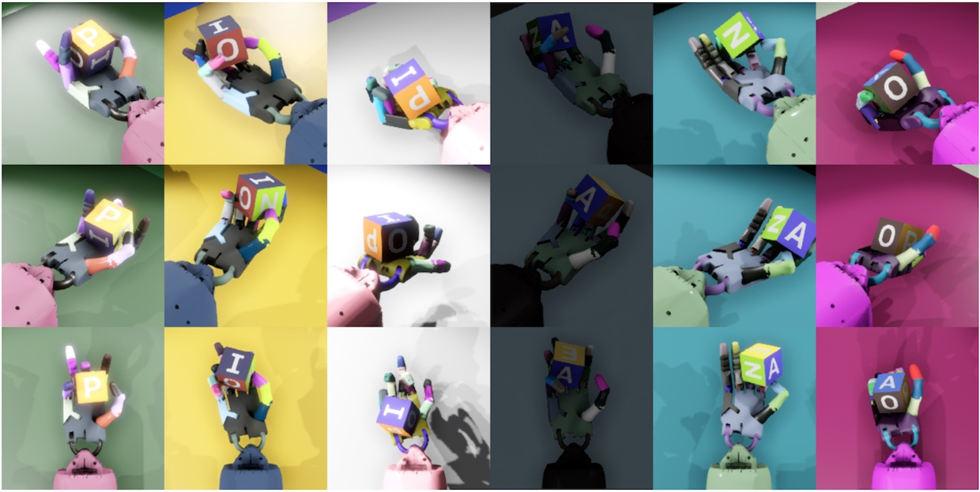
Challenges
[1] OpenAI, “Learning Dexterous In-Hand Manipulation”
Notes:
There are three key challenges. First, learning informative representations of the states from raw images is difficult.

Slide 4
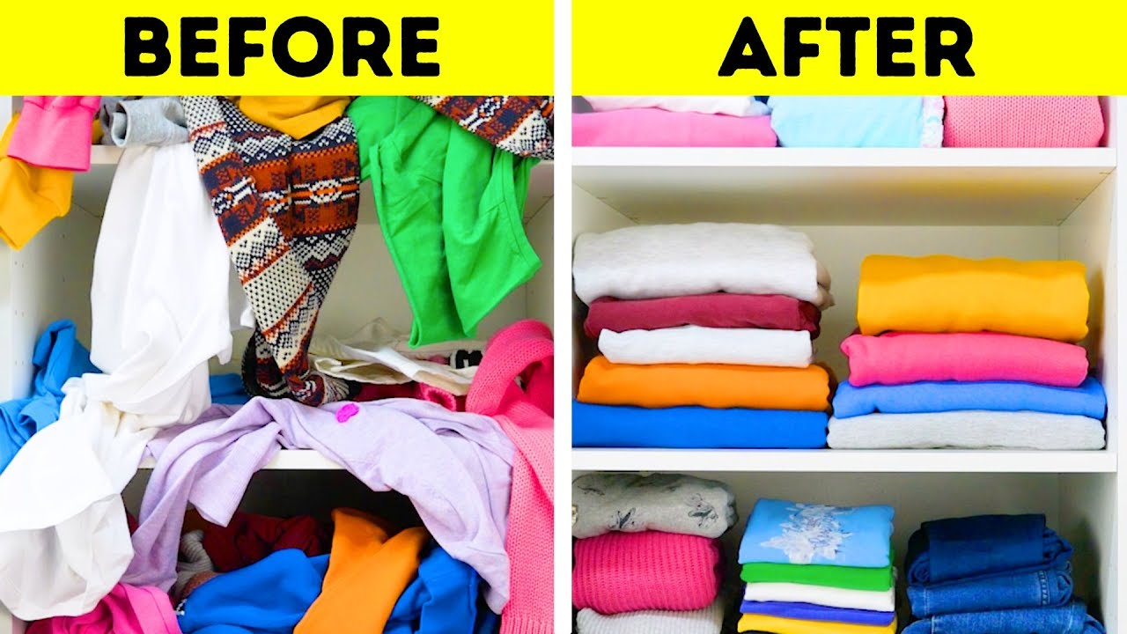
Challenges
Notes:
Second, the dynamics of real-world objects are always complex and nonlinear, especially for deformable objects.

Slide 5
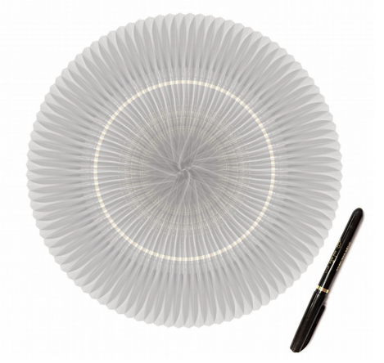
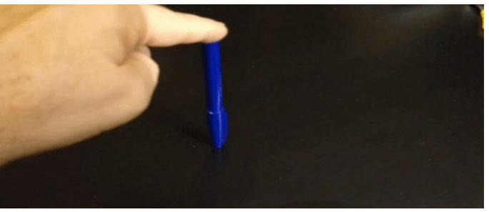
Challenges
[1] Credits to Yann LeCun, “Energy-Based Self-Supervised Learning”
Notes:
Third, modeling the stochasticity of the agent-environment system is extremely challenging. The stochasticity mainly comes from two aspects: the noise in the agent’s actuation and the inherent uncertainty in the environment, both of which cannot be ignored.

Slide 6




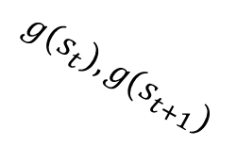
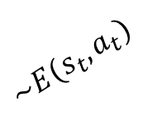
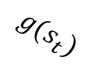



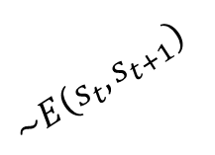











Method - Overview
Maximize agreement
$${\tilde{a}}_{t}$$
$$a_{t}$$
$${\tilde{h}}_{t+1}$$
$$h_{t+1}$$
$$p({\tilde{z}}_{t})$$
Maximize agreement
$$p(z_{t})$$
$$F(h_{t},q(a_{t}))$$
$$g(s_{t+1})$$
$${\tilde{z}}_{t}$$
$$z_{t}$$
$$I(h_{t},h_{t+1})$$
$$q(a_{t})$$
$$h_{t}$$
$$s_{t+1}$$
$$h_{t},h_{t+1}$$
$$a_{t}$$
$$g(s_{t})$$
$$\sim E(s_{t},a_{t})$$
$$g\left(s_{t}\right),g(s_{t+1})$$
$$\sim E(s_{t},s_{t+1})$$
$$s_{t},a_{t}$$
$$s_{t},s_{t+1}$$
Notes:
In this paper, we introduce a novel method, named CLOUD, that uses contrastive learning to handle all the above challenges. We jointly train a forward dynamics model, an inverse dynamics model, a state representation model, and an action representation model with contrastive objectives. The forward dynamics model is trained to maximize the agreement between the predicted and the observed next state representations; the inverse dynamics model is trained to maximize the agreement between the predicted and the ground truth action representations.
We’ll go through each module in detail.

Slide 7




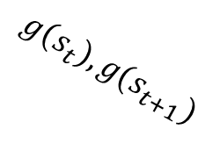
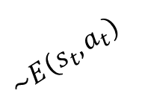
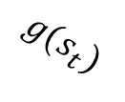



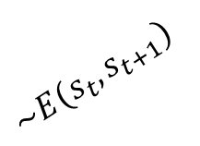













Method – State and Action Representation Models
Maximize agreement
$${\tilde{a}}_{t}$$
$$a_{t}$$
$${\tilde{h}}_{t+1}$$
$$h_{t+1}$$
$$p({\tilde{z}}_{t})$$
Maximize agreement
$$p(z_{t})$$
$$F(h_{t},q(a_{t}))$$
$$g(s_{t+1})$$
$${\tilde{z}}_{t}$$
$$z_{t}$$
$$I(h_{t},h_{t+1})$$
$$q(a_{t})$$
$$h_{t}$$
$$s_{t+1}$$
$$h_{t},h_{t+1}$$
$$a_{t}$$
$$g(s_{t})$$
$$\sim E(s_{t},a_{t})$$
$$g\left(s_{t}\right),g(s_{t+1})$$
$$\sim E(s_{t},s_{t+1})$$
$$s_{t},a_{t}$$
$$s_{t},s_{t+1}$$
$$h=g(s)$$
$$z=q(a)$$
Notes:
The benefits of capturing the structure in the underlying state space is a well understood and widely used concept in robotics. Given a set of states {s} ⊆ S (where the states are raw sensory inputs), the goal of state representation model g(·) is to encode high-dimensional images s into informative representations h. State representations allow the policy to generalize across states. Naturally, such features would be useful later for planning.
Similarly, there often exists additional structure in the space of actions that can be leveraged. Given a set of actions {a} ⊆ A, we introduce an action representation model q(·) to encode actions a into embeddings z.

Slide 8

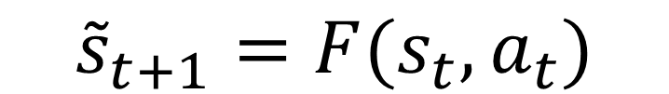
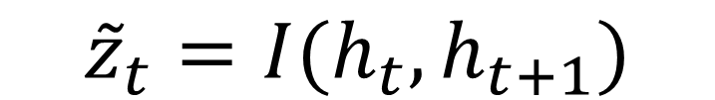
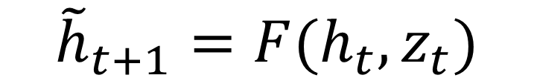
Method – Forward and Inverse Dynamics
Maximize agreement
$${\tilde{a}}_{t}$$
$$a_{t}$$
$${\tilde{h}}_{t+1}$$
$$h_{t+1}$$
$$p({\tilde{z}}_{t})$$
Maximize agreement
$$p(z_{t})$$
$$F(h_{t},q(a_{t}))$$
$$g(s_{t+1})$$
$${\tilde{z}}_{t}$$
$$z_{t}$$
$$I(h_{t},h_{t+1})$$
$$q(a_{t})$$
$$h_{t}$$
$$s_{t+1}$$
$$h_{t},h_{t+1}$$
$$a_{t}$$
$$g(s_{t})$$
$$\sim E(s_{t},a_{t})$$
$$g\left(s_{t}\right),g(s_{t+1})$$
$$\sim E(s_{t},s_{t+1})$$
$$s_{t},a_{t}$$
$$s_{t},s_{t+1}$$
$${\tilde{s}}_{t+1}=F(s_{t},a_{t})$$
$${\tilde{h}}_{t+1}=F(h_{t},z_{t})$$
$${\tilde{a}}_{t}=I(s_{t},s_{t+1})$$
$${\tilde{z}}_{t}=I(h_{t},h_{t+1})$$
Notes:
Let {(st, at, st+1)} represent a set of state-action-state tuples. A model that predicts the state of the next timestep s˜t+1 given current state and action st, at is known as a forward dynamics model F (·). Instead of directly learning a dynamics model through pixel space, we consider to make predictions in a learned latent space. Because making predictions in raw sensory space is hard and can always be distracted by irrelevant information.
On the other hand, a model that predicts the action at that relates a pair of input states (st, st+1) is called an inverse dynamics model I(·). Similarly, we consider to make predictions in a learned action space.

Slide 9
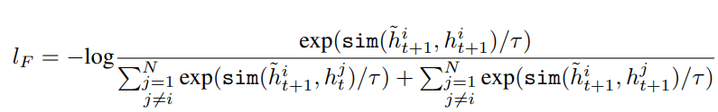
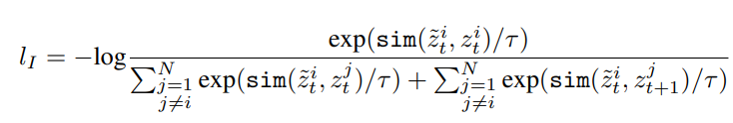
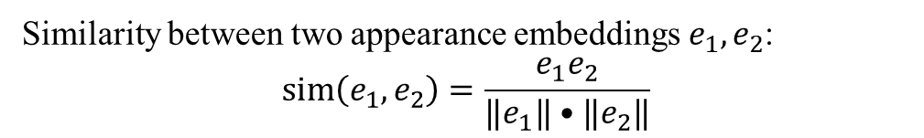
Method – Contrastive Estimation
Maximize agreement
$${\tilde{a}}_{t}$$
$$a_{t}$$
$${\tilde{h}}_{t+1}$$
$$h_{t+1}$$
$$p({\tilde{z}}_{t})$$
Maximize agreement
$$p(z_{t})$$
$$F(h_{t},q(a_{t}))$$
$$g(s_{t+1})$$
$${\tilde{z}}_{t}$$
$$z_{t}$$
$$I(h_{t},h_{t+1})$$
$$q(a_{t})$$
$$h_{t}$$
$$s_{t+1}$$
$$h_{t},h_{t+1}$$
$$a_{t}$$
$$g(s_{t})$$
$$\sim E(s_{t},a_{t})$$
$$g\left(s_{t}\right),g(s_{t+1})$$
$$\sim E(s_{t},s_{t+1})$$
$$s_{t},a_{t}$$
$$s_{t},s_{t+1}$$
Similarity between two appearance embeddings $e_{1},e_{2}$:
$$\operatorname{sim}\left(e_{1},e_{2}\right)=\frac{e_{1}e_{2}}{‖e_{1}‖•‖e_{2}‖}$$
Notes:
Inspired by recent contrastive learning algorithms, we propose to train these models by maximizing agreement between predicted and real representations via a contrastive loss. Here we use cosine similarity to denote the distance between two representation.
We randomly sample a minibatch of N state action-state tuples {(s i t , ai t , si t+1)}. For forward dynamics model, a prediction h˜i t+1 and real representation h i t+1 from the same tuple is defined as positive example. We treat the other 2(N − 1) real representation within a minibatch as negative examples.
Similarly, for inverse dynamics model, we define the loss function.
During joint training, the total loss is computed across all positive pairs in a mini-batch.

Slide 10
Experiment Setups
Goal-Directed Planning
Imitation From Observations
Planning with MPC[1]
MuJoCo physics Engine[2]
Evaluation Metric: Success Rate
Iterative Applying Inverse Dynamics [3]
MuJoCo physics Engine
Evaluation Metric: Success Rate
[1] https://en.wikipedia.org/wiki/Model_predictive_control
[2] Todorov , Emo et al. “Mujoco: A physics engine for model-based control.”, ICIRS2012
[3] Nair, Ashvin et al. “Combining self-supervised learning and imitation for vision-based rope manipulation.”, ICRA2017
Notes:
We evaluate our proposed method in comparison with classical baseline methods on two tasks, goal directed planning and imitation from observations on rope manipulation. For goal-directed planning, we propose to plan with a simple version of model predictive control. We calculate the success rate on MuJoCo rope. We also evaluate the performance of our proposed method on imitation from observation.

Slide 11
Experiments – Goal-Directed Planning
[1] Lange, Sascha, et al. “Deep auto-encoder neural networks in reinforcement learning.”, IJCNN2010
[2] Hafner, Danijar et al. “Learning Latent Dynamics for Planning from Pixels.”, ICML2019
[3] Agrawal, Pulkit et al. “Learning to poke by poking: Experiential learning of intuitive physics.”, NIPS2016

Slide 12
Experiments – Imitation From Observations
[1] Nair, Ashvin et al. “Combining self-supervised learning and imitation for vision-based rope manipulation.”, ICRA2017

Slide 13
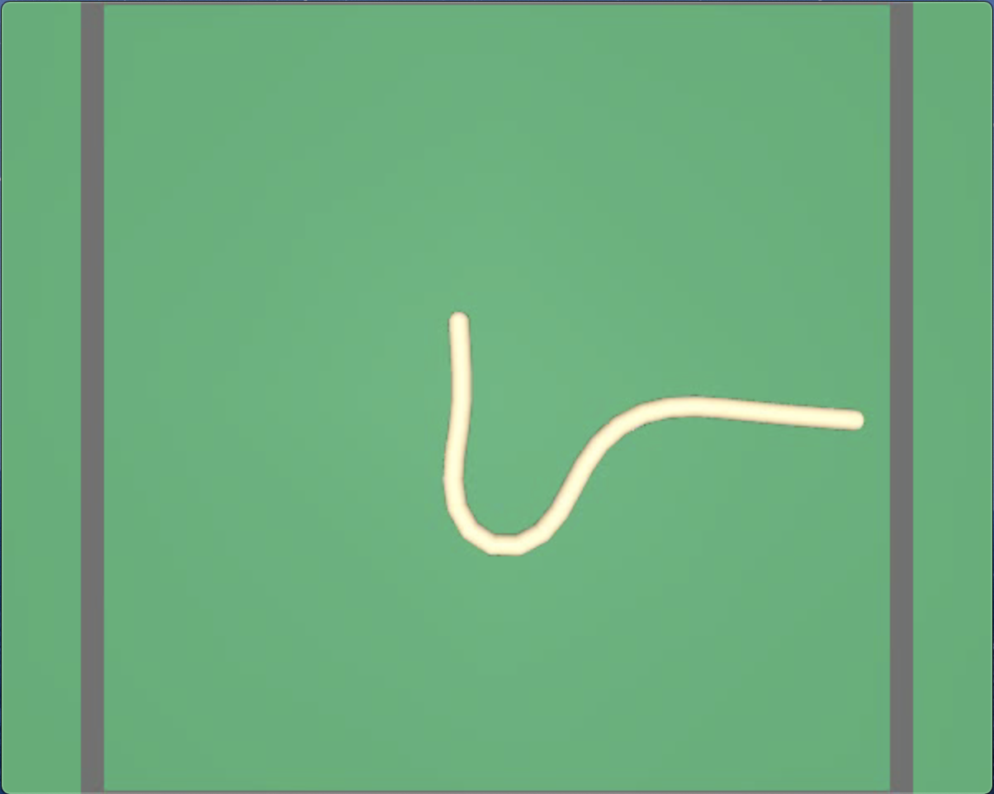
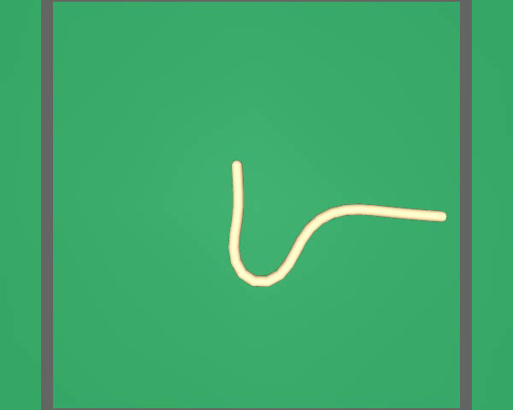
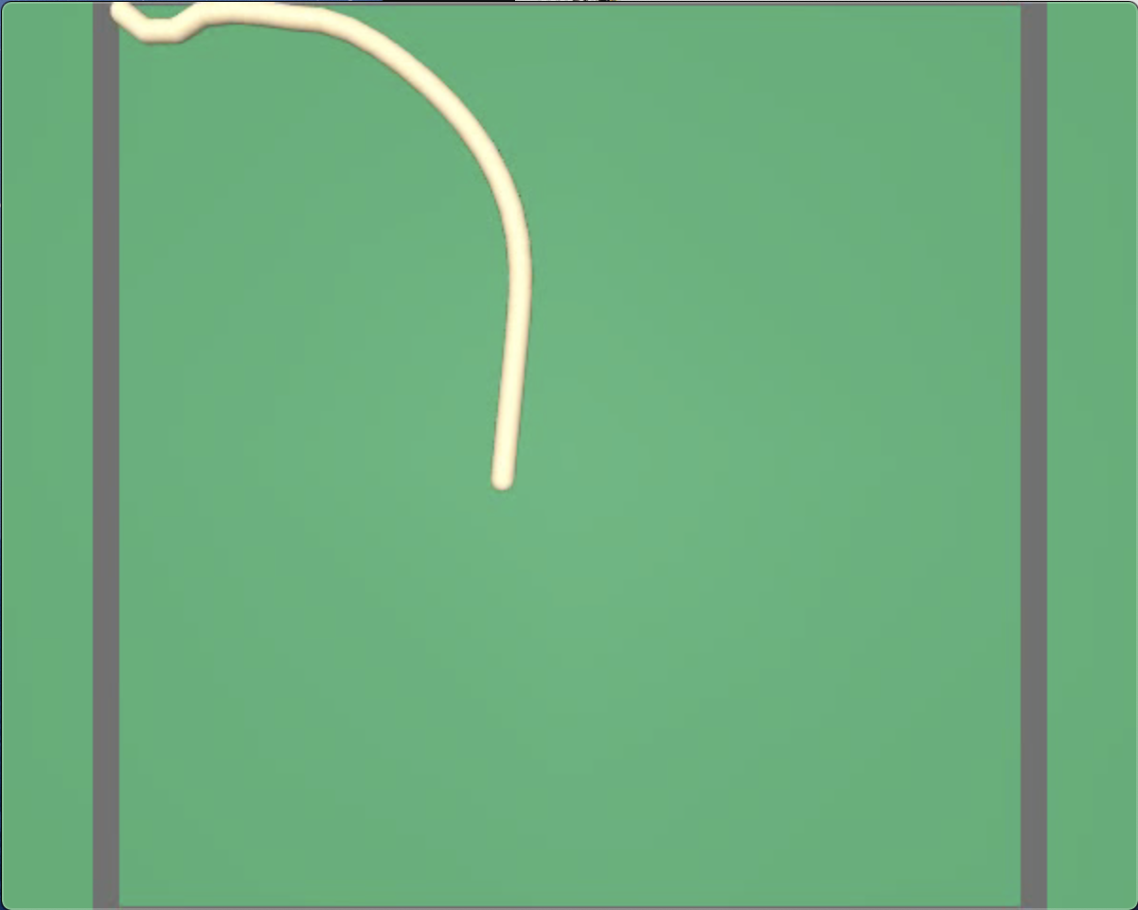
Qualitative – Goal-Directed Planning
Start
Goal

Slide 14
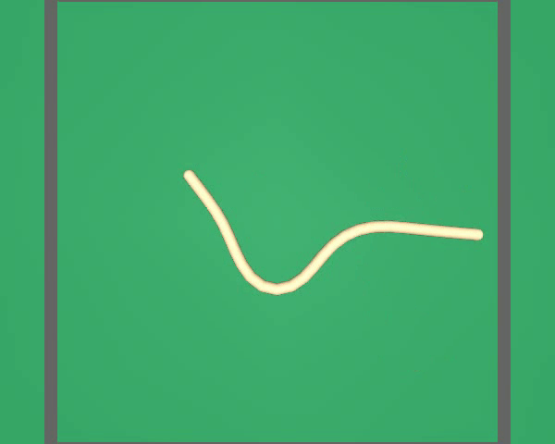
Qualitative – Imitation From Observations
Demonstration
Imitation

Slide 15
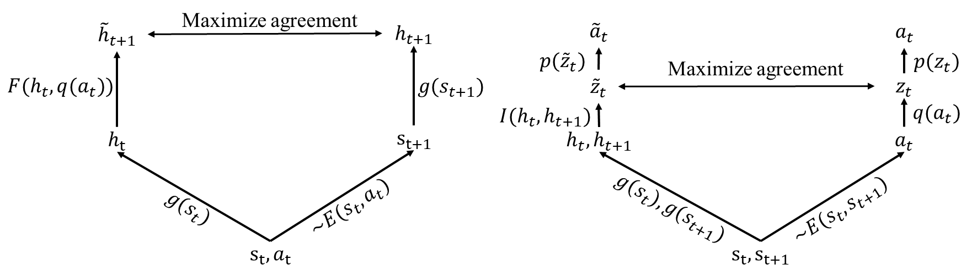

Conclusion
A contrastive estimation framework for unsupervised dynamics learning
A new way to learn plannable representations, dynamics models that can handle stochasticity of the environment.
Effective for both goal conditioned planning and imitation from observations
Project Page
Notes:
Please check our paper and project page for more details.

