Slide 1
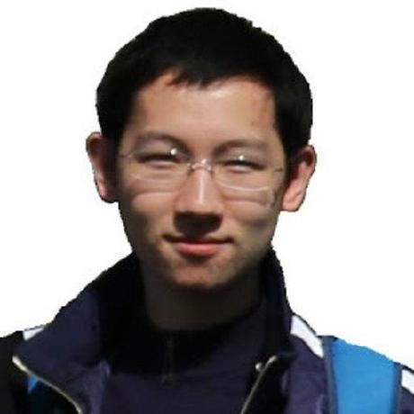






Uncertainty-aware Self-supervised 3D Data Association
Jianren Wang¹, Siddharth Ancha¹, Yi-Ting Chen², David Held¹
¹CMU RI
²Honda Research Institute
Notes:
Hello Everyone, I am Jianren Wang from CMU. Today I am going to talk about “Uncertainty-aware Self-supervised 3D Data Association”. This is joint work with Siddharth Ancha, Yi-Ting Chen, David Held

Slide 2
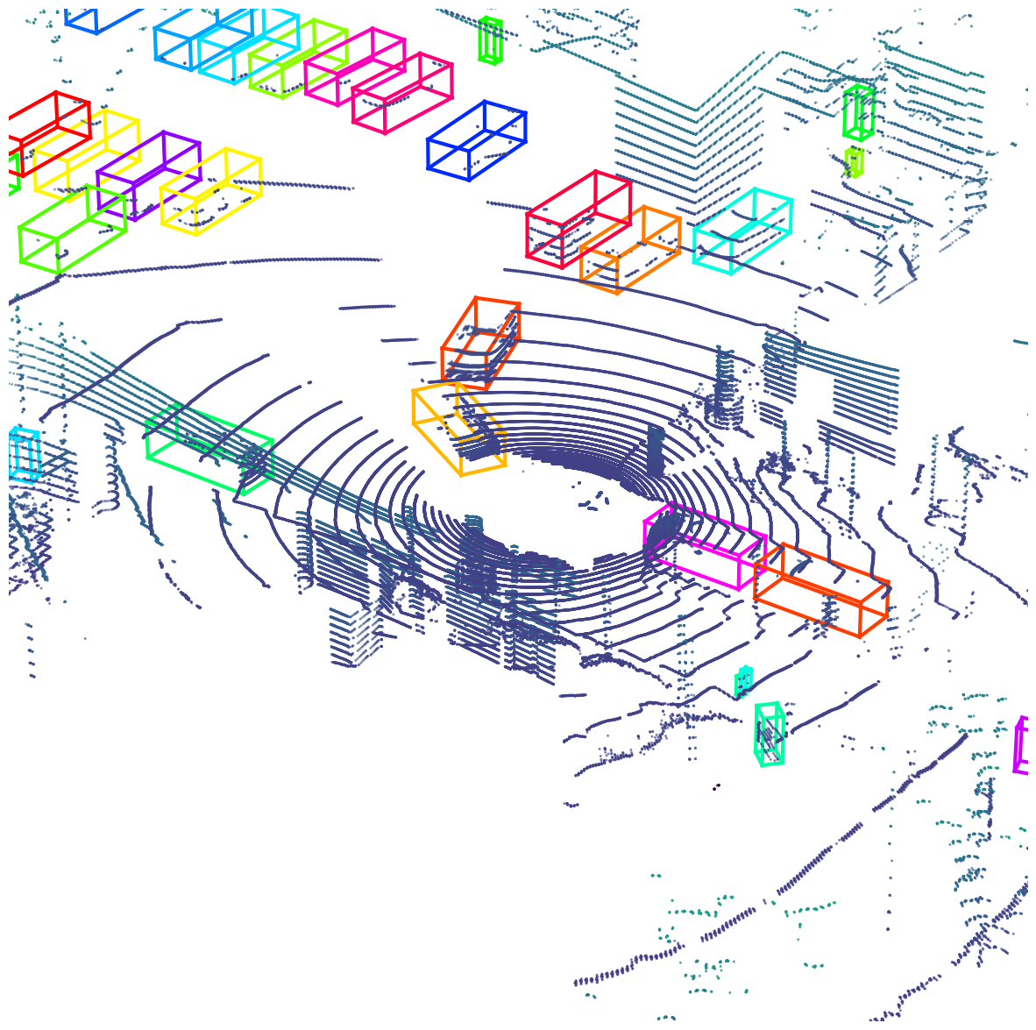
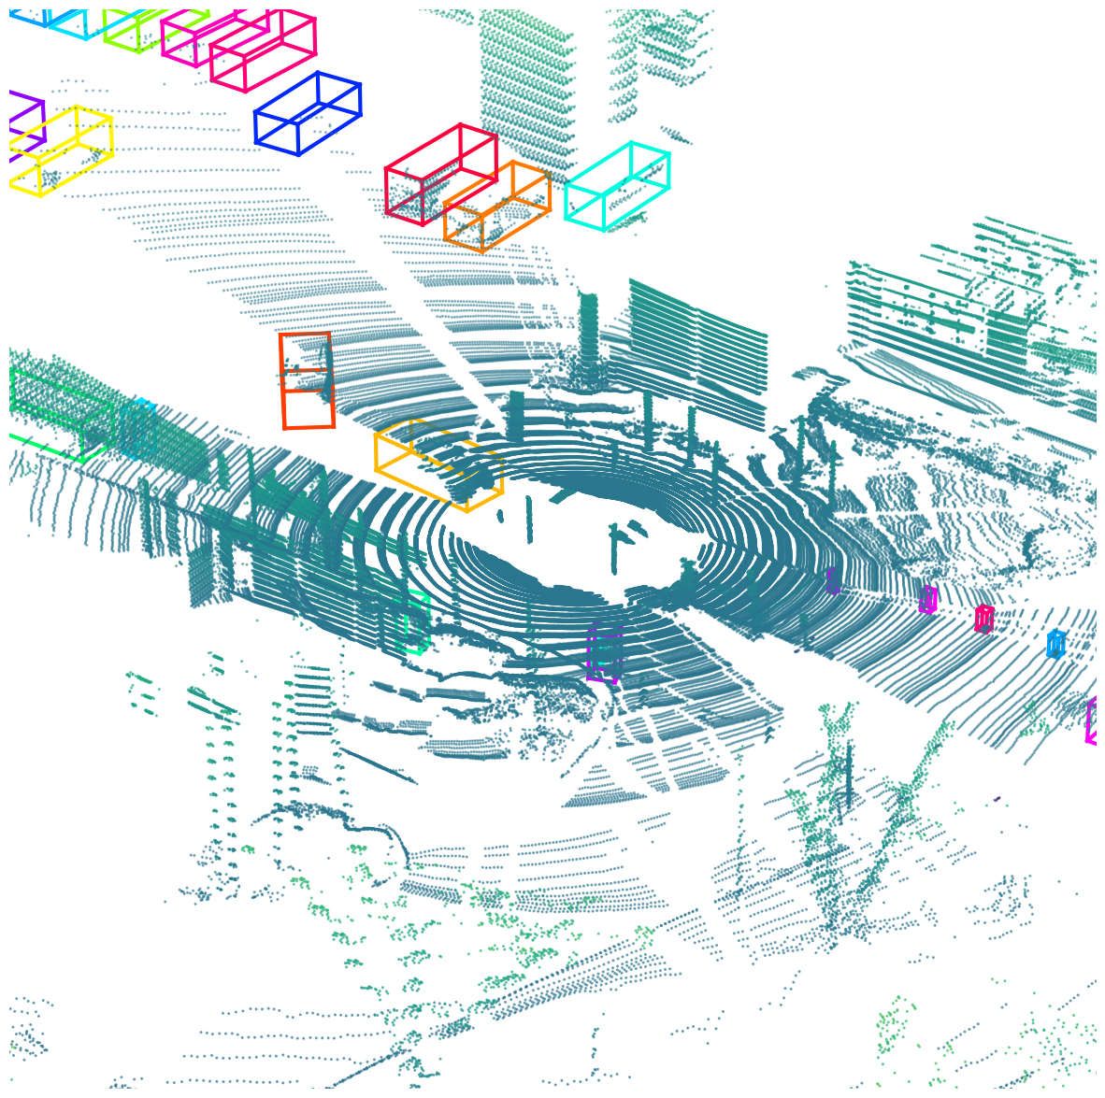
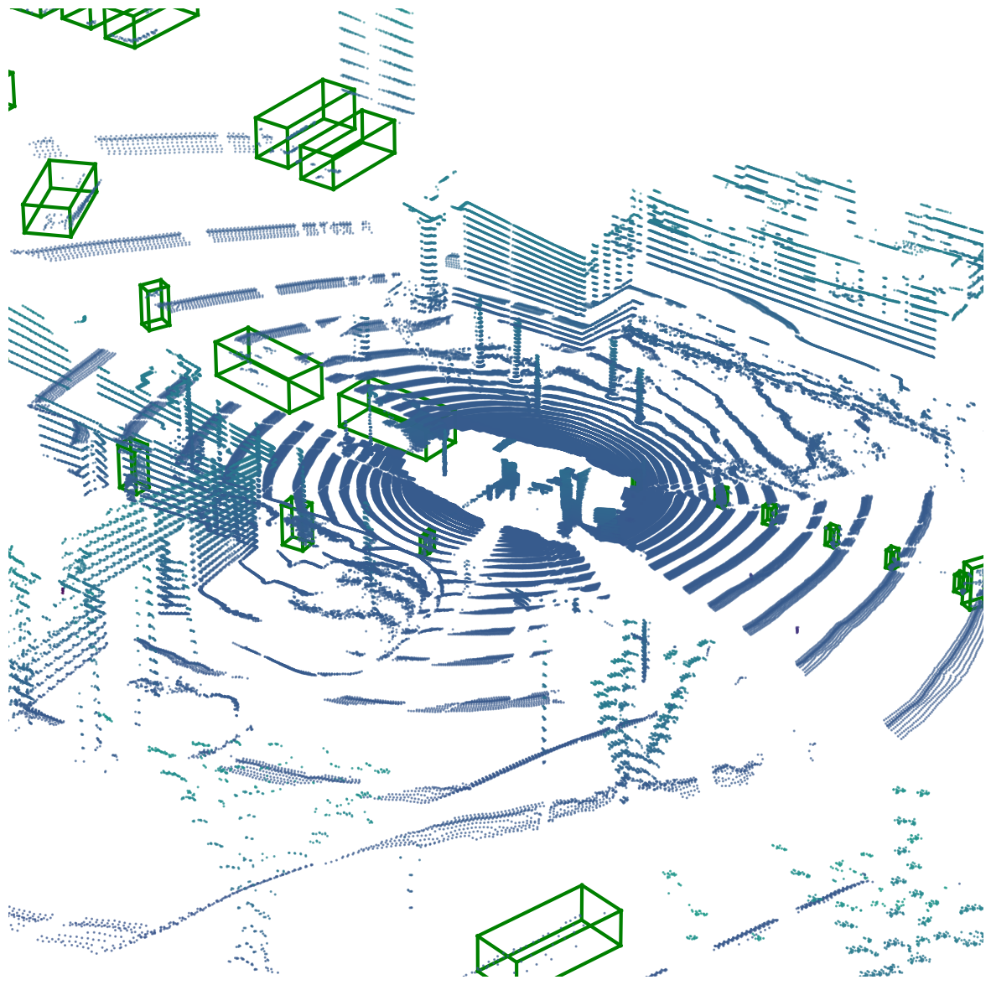
Task: 3D Data Association
Sensor Data
Detection
Data Association
Forecasting and Motion
Planning
Data Association
Action
Frame 1, … , t -1
Frame t
Tracks
Detections
Tracking ID 1
Tracking ID 2
Detection 1
Tracking ID 3
Detection 2
Tracking ID 4
Tracking ID 5
Detection 3
Detection 4
Notes:
Traditional autonomous driving systems are composed of a set of modules executed one after another. The vehicle first senses its environment as a LIDAR point cloud. A detection module is then used to estimate the locations of objects in the environment surrounding the vehicle. Further, in order to safely navigate in its surroundings, a data association module is used to associate detections with existing tracks to understand their dynamics. The results are then used for trajectory forecasting and motion planning.
In this work, we focus on the problem of 3D data association. Given a set of existing tracks from frame 1 to frame t-1, and detections in frame t. The goal is to associate object detections in frame t with tracks that have the same IDs.

Slide 3
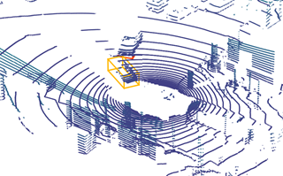
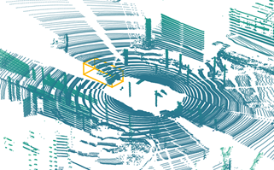
Previous Approaches: Motion Prediction
Kalman Filter
Frame 1, … , t -1
Frame t
Track i
Detections
[1] Weng, Xinshuo, et al. “3D Multi-Object Tracking: A Baseline and New Evaluation Metrics”, IROS2020
[2] Zhu, Benjin, et al. “Probabilistic 3D Multi-Object Tracking for Autonomous Driving”, arXiv
Notes:
Traditionally, data association is obtained using motion prediction, such as using a Kalman filter. Given a track, prior works first predict the location of the object in the next time step. Distances between object detections and the prediction are then calculated using the probability under the predicted distribution. Given these distances, optimization algorithms, such as the Hungarian algorithm, are used for data association.

Slide 4




Previous Approaches: Appearance Similarity
Frame 1, … , t -1
$$e_{T}$$
$$e_{D_{1}}$$
Frame t
Track i
Detections
$$e_{D_{2}}$$
$$Appearance Similarity[1,2,3]: cos\left(e_{T}, e_{D}\right)$$
[1] Giancola, Silvio, et al. “Leveraging Shape Completion for 3D Siamese Tracking.”, CVPR2019
[2] Weng, Xinshuo, et al. “Graph Neural Network for 3D Multi-Object Tracking with 2D-3D Multi-Feature Learning.”, CVPR2019
[3] Zhang, Weiwei, et al. “Robust Multi-Modality Multi-Object Tracking.”, ICCV2019
Notes:
However, this traditional approach does not use any object appearance information. Recent works propose to associate tracks with object detections based on appearance similarity. Convolutional neural networks are used to extract appearance embeddings of tracks and detections. The cosine similarity between these embeddings are used for data association.

Slide 5
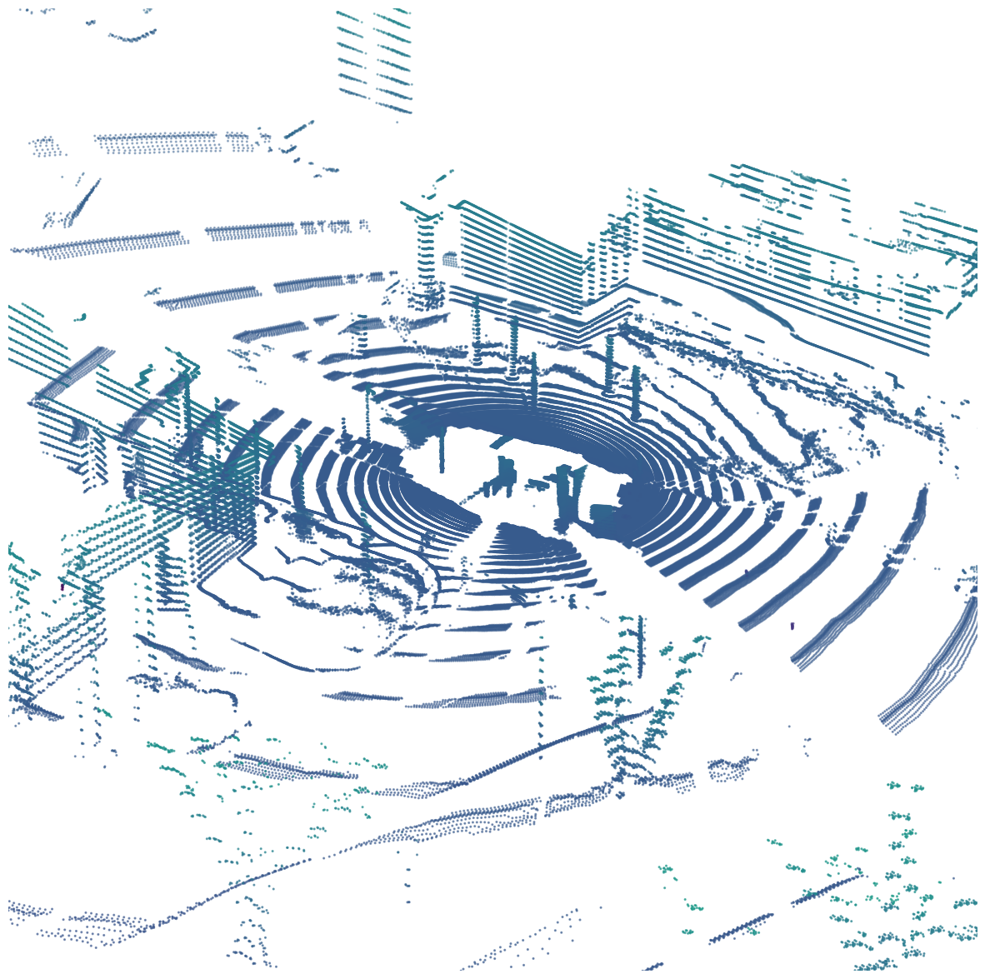

How do we learn these embeddings?
Frame 1, … , t -1
Frame t
Tracks
Detections
Tracking ID 1
Tracking ID 2
Detection 1
Tracking ID 3
Detection 2
Tracking ID 4
Tracking ID 5
Detection 3
Detection 4
Labeled 3D annotations – hard and expensive
Unlabeled data – Cheaply available
Can we learn 3D embedding from unlabeled data?
YES!
Notes:
However, how to learn these appearance embeddings remains a big problem. State-of-the-art approaches require vast amounts of labeled associations across frames. Obtaining large-scale, human-annotated labeled data can be expensive and time-intensive. On the contrary, vast amounts of unlabeled data is cheaply available. For example, LIDAR sensors fitted on vehicles continuously collect and store data streams without requiring any human processing.
A natural question is “Can we learn 3D embedding from unlabeled data?” And the answer is YES.

Slide 6
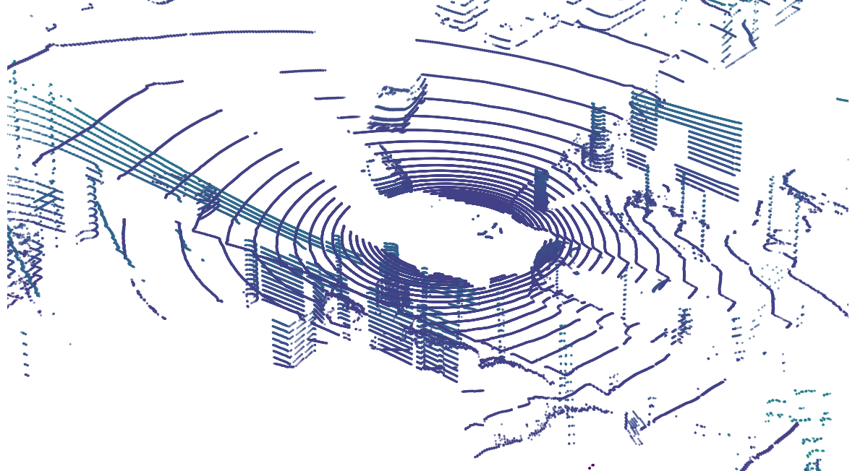
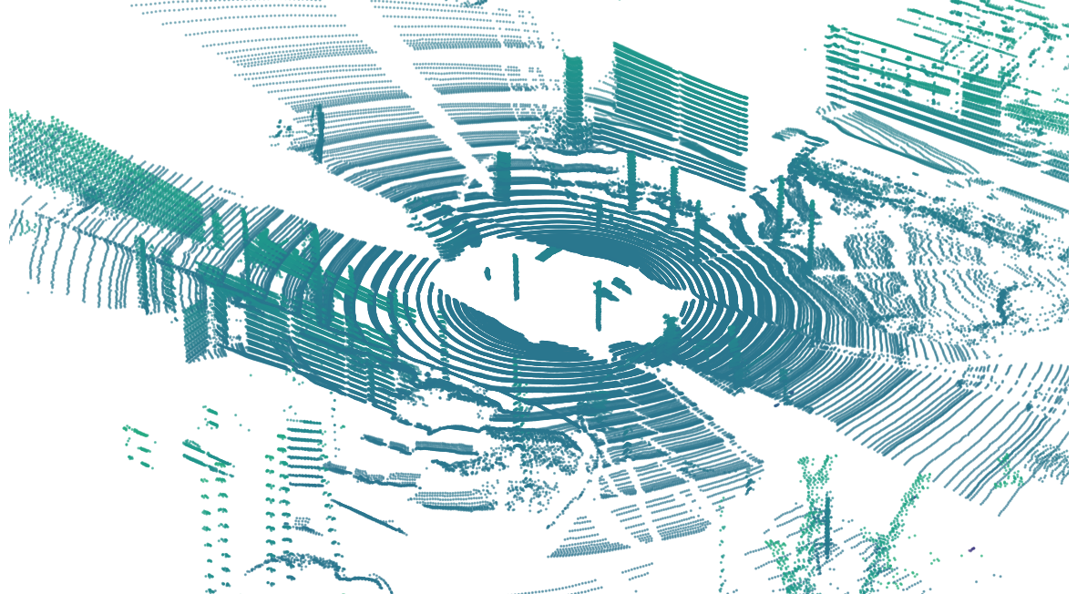
Method - Overview
Sensor Data
Object Detection
Self-supervised Data Association
Uncertainty-aware
Weighting
Learning an Embedding
Frame t
Frame t + k
Notes:
In this work, we propose to leverage unlabeled data via uncertainty-aware self-supervised learning of 3D data association without the need for any labeled data.
Here is an overview of our method:
Given a large amount of unlabeled data,

Slide 7
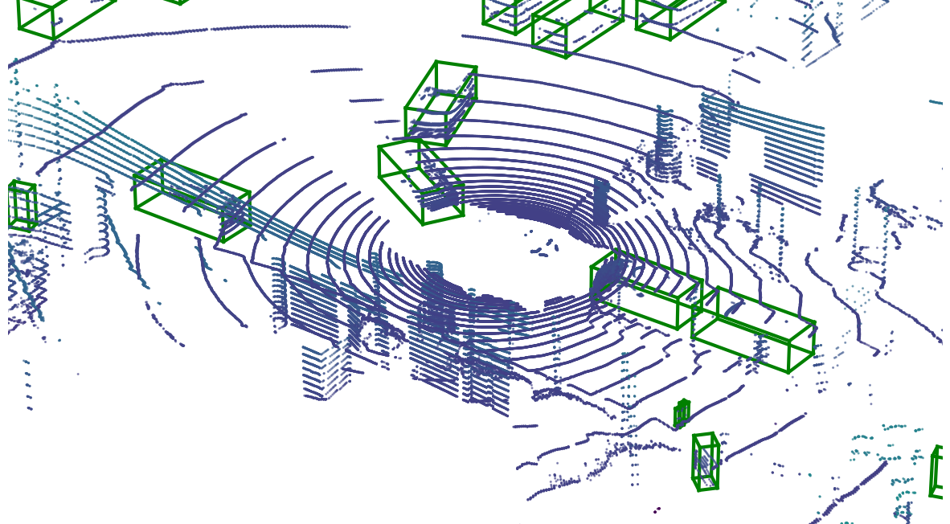
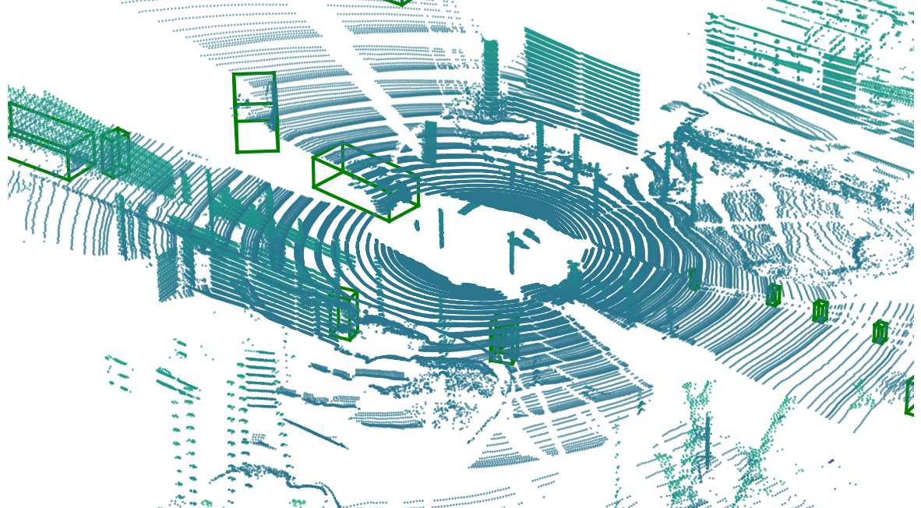
Method - Overview
Sensor Data
Object Detection
Self-supervised Data Association
Uncertainty-aware
Weighting
Learning an Embedding
Frame t
Frame t + k
Notes:
We first run a learned object detector on large unlabeled datasets.

Slide 8
Method - Overview
Sensor Data
Object Detection
Self-supervised Data Association
Uncertainty-aware
Weighting
Learning an Embedding
Frame t
Frame t + k
Notes:
We then performing self-supervised data associations.

Slide 9
Method - Overview
Sensor Data
Object Detection
Self-supervised Data Association
Uncertainty-aware
Weighting
Positive Pair with Uncertainty
Learning an Embedding
Frame t
Frame t + k
Notes:
To suppress the contribution of incorrect associations during self-supervised training, we propose uncertainty-aware weighting.

Slide 10

Method - Overview
Sensor Data
Object Detection
Self-supervised Data Association
Uncertainty-aware
Weighting
Hard Negative Pair
Learning an Embedding
Positive Pair with Uncertainty
Frame t
Frame t + k
Notes:
Finally, we learn a point cloud embedding using the triplet loss, such that embeddings are similar for detections of the same object in different views but are dissimilar for detections of different objects.
We also propose to use hard negative mining to obtain a more robust embedding.
We’ll go through each module in detail.

Slide 11
Method – Obtain Associations by Self-Supervision
Kalman Filter
Frame 1, … , t -1
Frame t
Track i
Detections
Detections from CBGS[2] detector trained on NuScenes
[1] Chiu, Hsu-kuang, et al. “Probabilistic 3D Multi-Object Tracking for Autonomous Driving”, arXiv
[2] Zhu, Benjin, et al. “Class-balanced Grouping and Sampling for Point Cloud 3D Object Detection”, arXiv
Notes:
First, we adopted a simple method used in previous work to generate a proposed data association. As in previous work, we use a Kalman filter to track objects; we use the predicted distribution of object locations to match tracks with detections. The resulting associations are treated as "pseudo-ground truth" by our method.

Slide 12
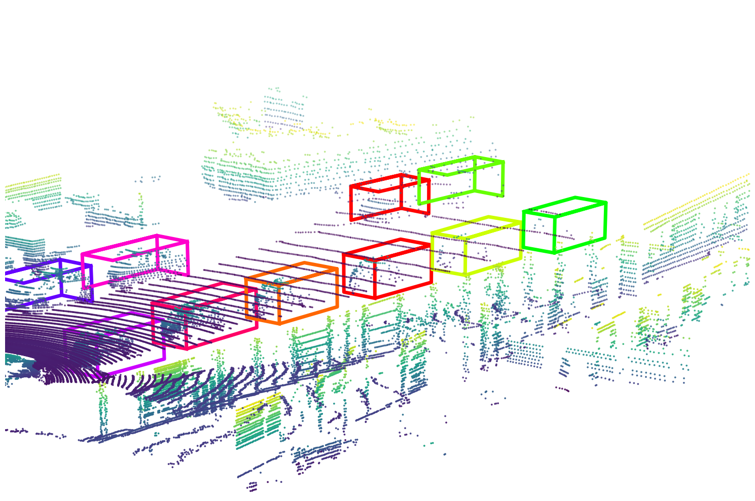
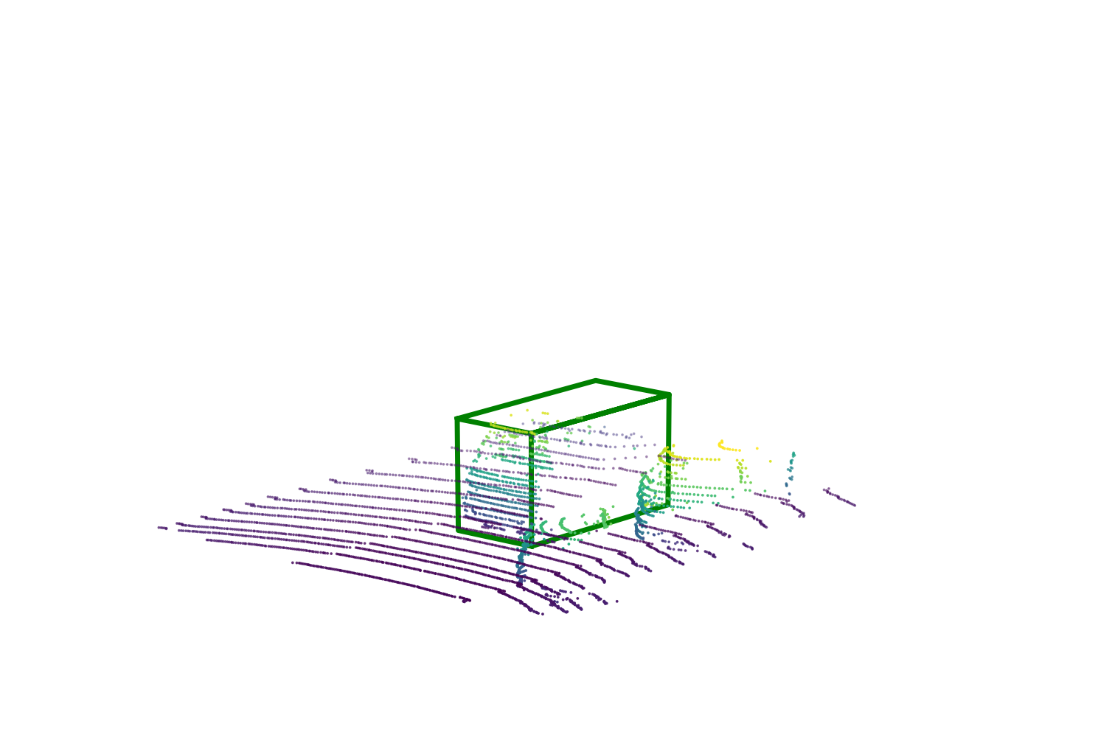
Method – Metric Learning via Triplet Loss
Crop and Center
PointNet[1]
Appearance
Embedding
[1] Qi, Charles et al. “PointNet: Deep Learning on Point Sets for 3D Classification and Segmentation.”, CVPR2017
Notes:
Given the estimated detections and associations, we wish to learn a 3D embedding for an arbitrary point cloud inside a bounding box. We first cropped point clouds are centered and aligned using the bounding box's location and pose. Then the PointNet is used to extract an embedding from a point cloud.
We define two properties that the embedding must satisfy: Embeddings of bounding boxes of the same object across frames must be similar. Embeddings of bounding boxes of different objects across frames must be dissimilar. The similarity can be measured using the cosine distance of the embedding. Where e_1, e_2 are 3D embeddings of two different point clouds. Such embeddings will be used to associate detected 3D bounding boxes at test time for 3D tracking. In order to learn such an embedding, we use the triplet loss, which is defined as follows. Let e_a be the embedding of an `anchor' detection in frame t, and e_p be the embedding of the same object in another frame t+k. Let e_n be the embedding of a different object in frame t and M is a margin hyperparameter. The triplet loss is zero when the cosine similarity between the positive pair is at least M more than the cosine similarity between the negative pair. The triplet loss encourages embeddings of positive pairs to be more similar to each other than embeddings of negative pairs.

Slide 13

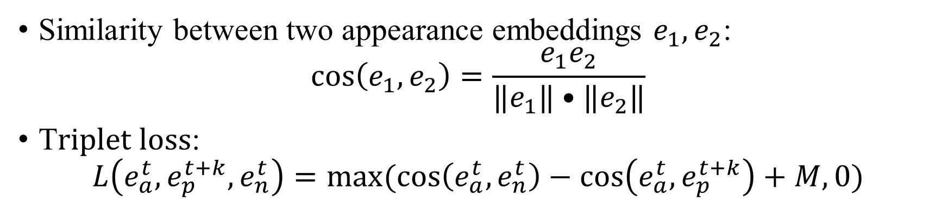



Method – Metric Learning via Triplet Loss
Dissimilar
Similar
t
t + k
Similarity between two appearance embeddings $e_{1},e_{2}$:
$$\cos\left(e_{1},e_{2}\right)=\frac{e_{1}e_{2}}{‖e_{1}‖•‖e_{2}‖}$$
T$riplet loss$:
$$L\left(e_{a}^{t},e_{p}^{t+k},e_{n}^{t}\right)=max⁡(\cos\left(e_{a}^{t},e_{n}^{t}\right)−\cos\left(e_{a}^{t},e_{p}^{t+k}\right)+M,0)$$
$$e_{a}^{t}:anchor detection in frame t$$
$e_{p}^{t+k}$ $:same object in frame t+k$
$$e_{n}^{t}:different object in frame t$$
$$M:Margin$$
Notes:
We define two properties that the embedding must satisfy: Embeddings of bounding boxes of the same object across frames must be similar. Embeddings of bounding boxes of different objects across frames must be dissimilar. The similarity can be measured using the cosine distance of the embedding. Where e_1, e_2 are 3D embeddings of two different point clouds. Such embeddings will be used to associate detected 3D bounding boxes at test time for 3D tracking. In order to learn such an embedding, we use the triplet loss, which is defined as follows. Let e_a be the embedding of an `anchor' detection in frame t, and e_p be the embedding of the same object in another frame t+k. Let e_n be the embedding of a different object in frame t and M is a margin hyperparameter. The triplet loss is zero when the cosine similarity between the positive pair is at least M more than the cosine similarity between the negative pair. The triplet loss encourages embeddings of positive pairs to be more similar to each other than embeddings of negative pairs.

Slide 14
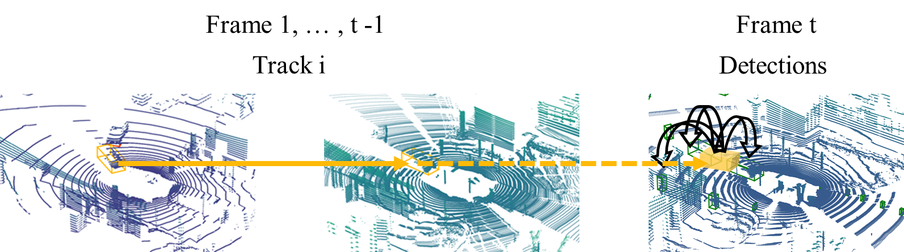
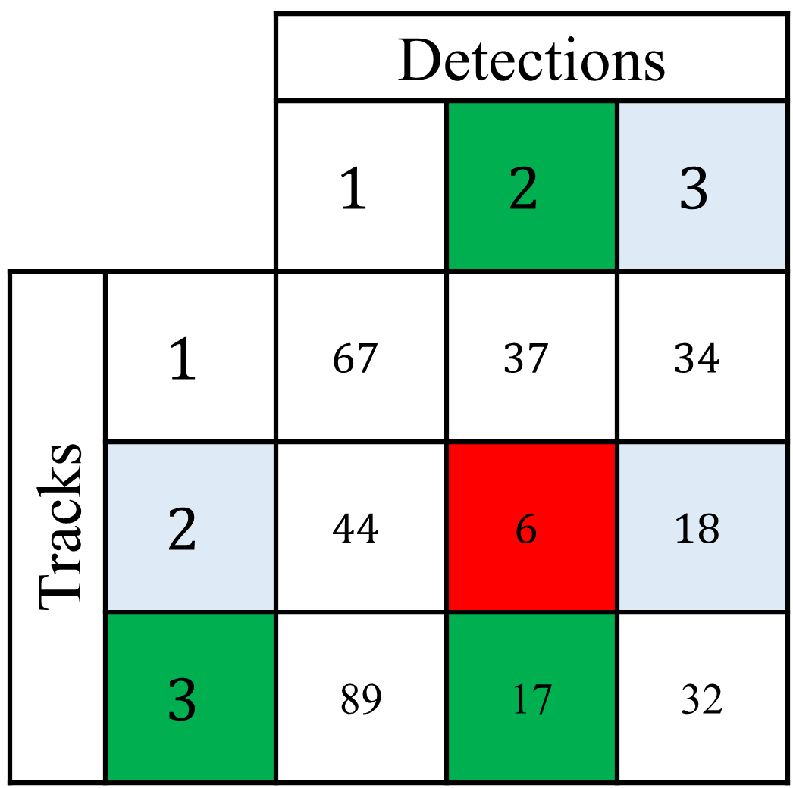
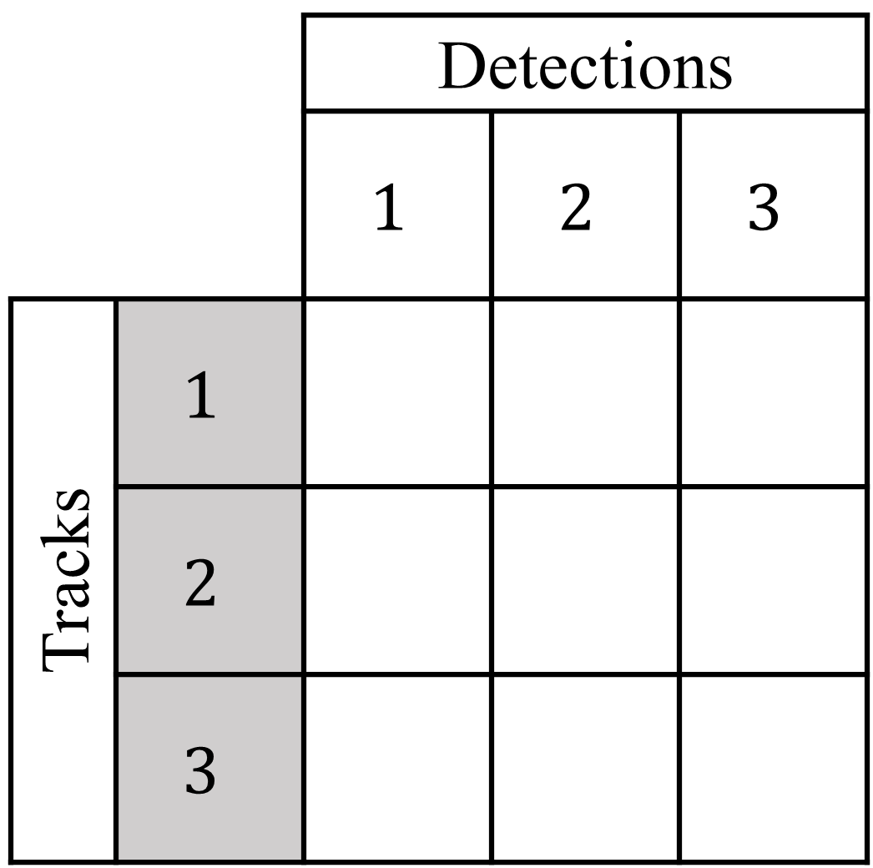
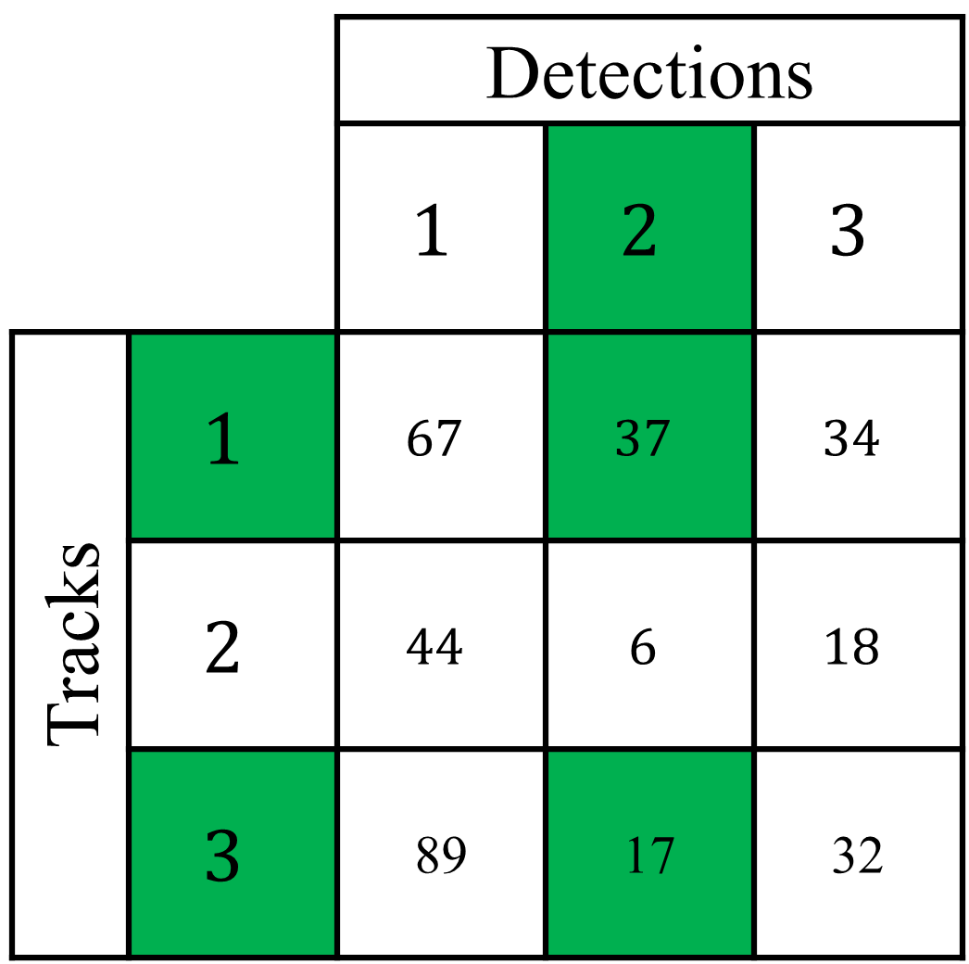
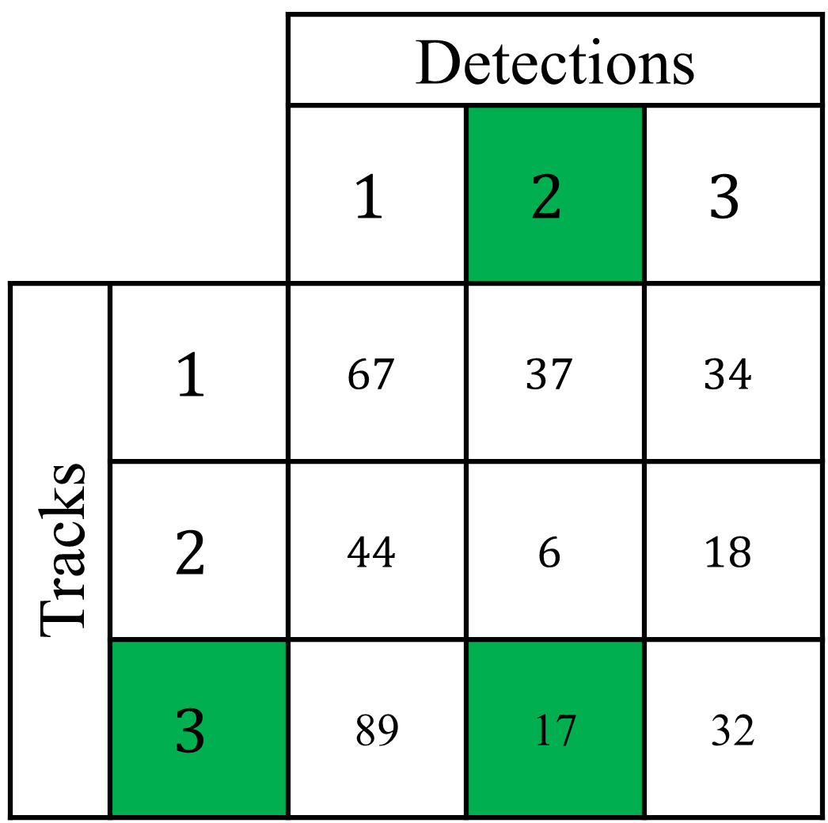
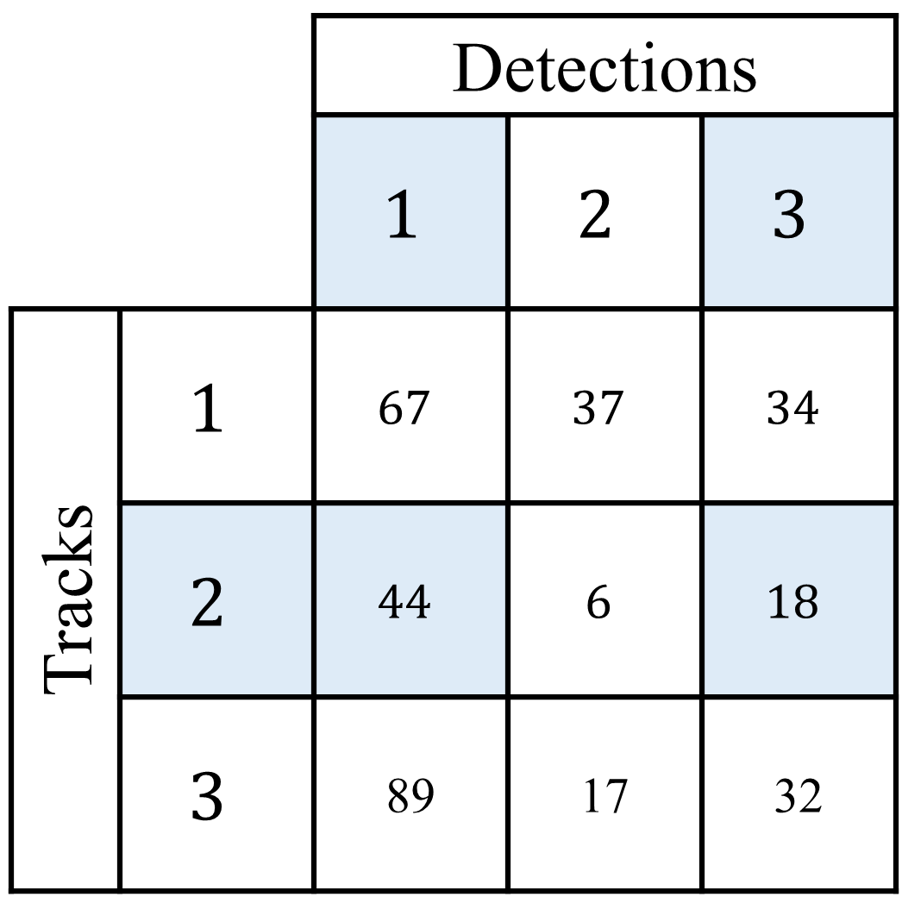
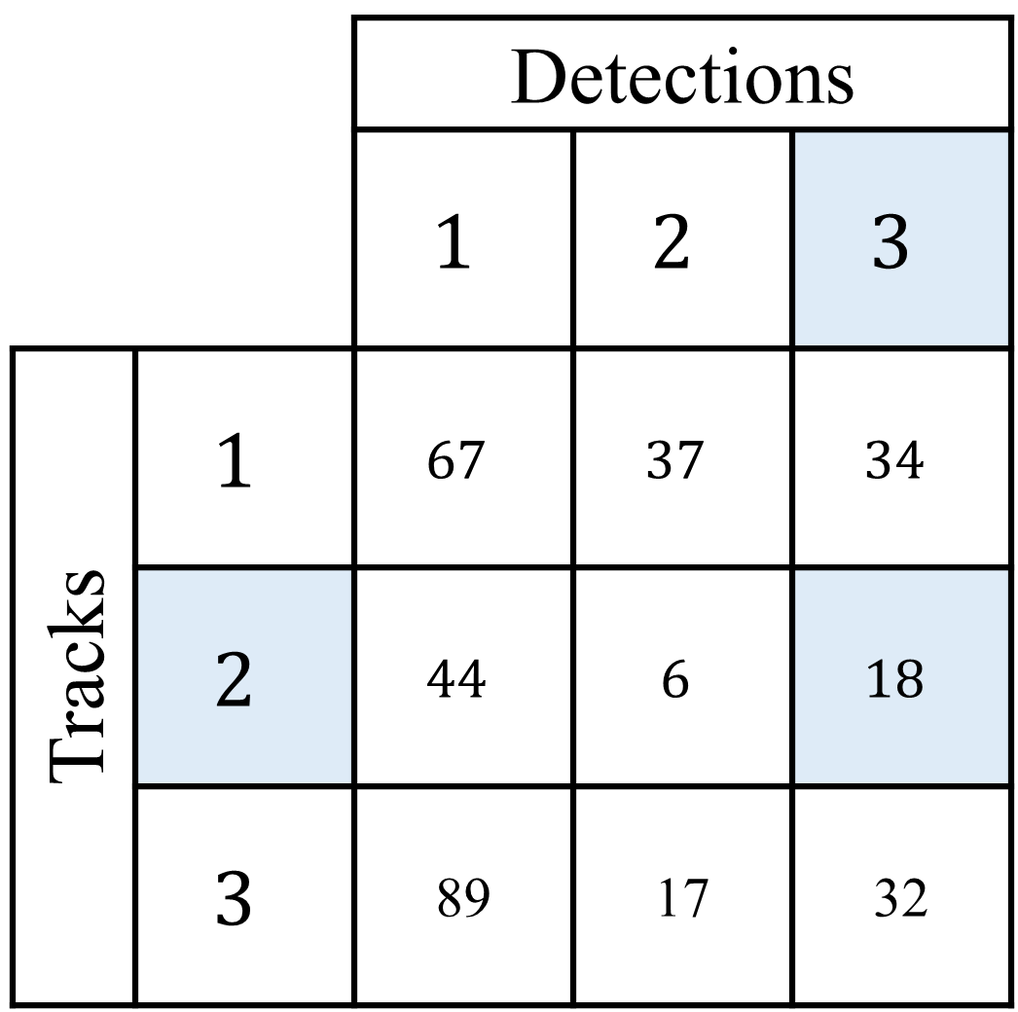
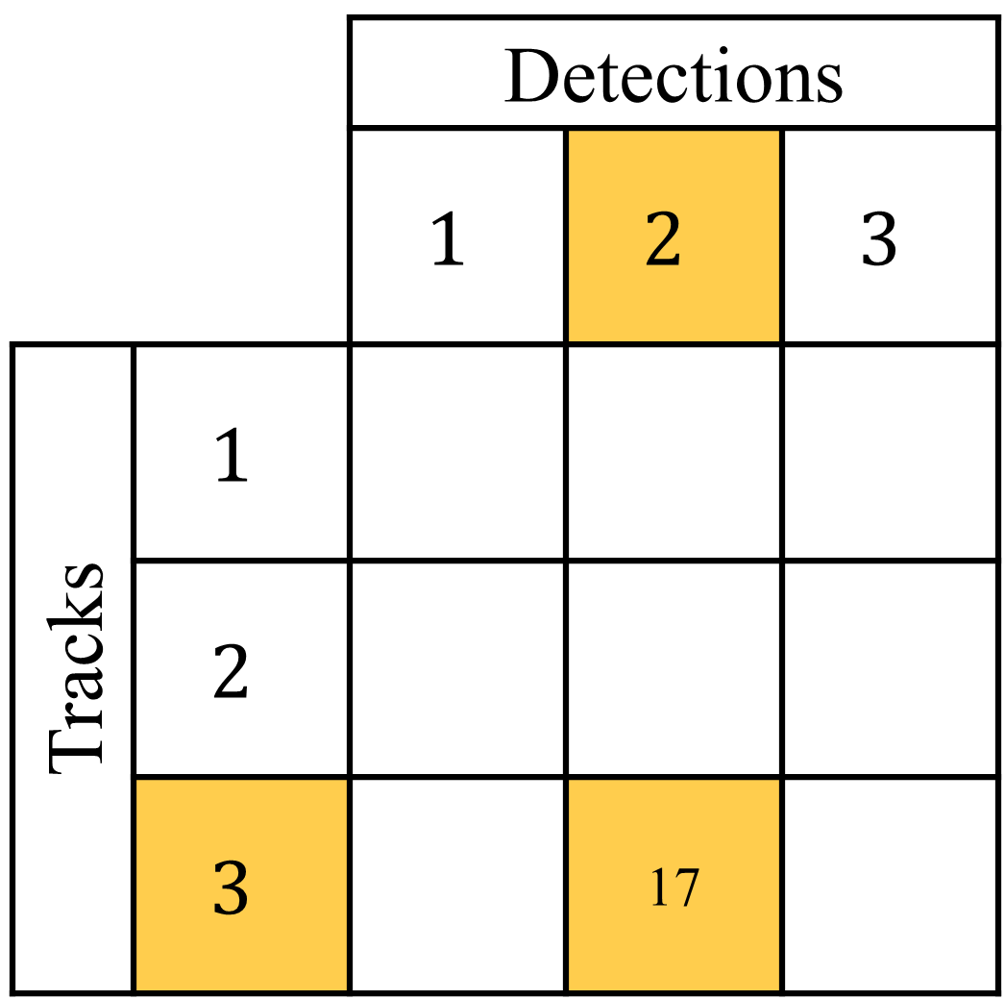
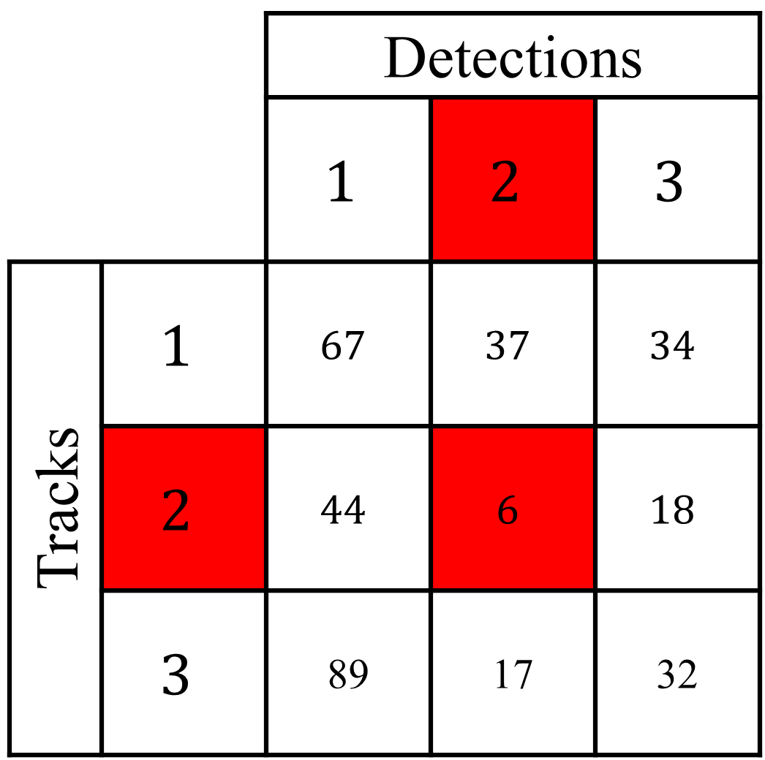
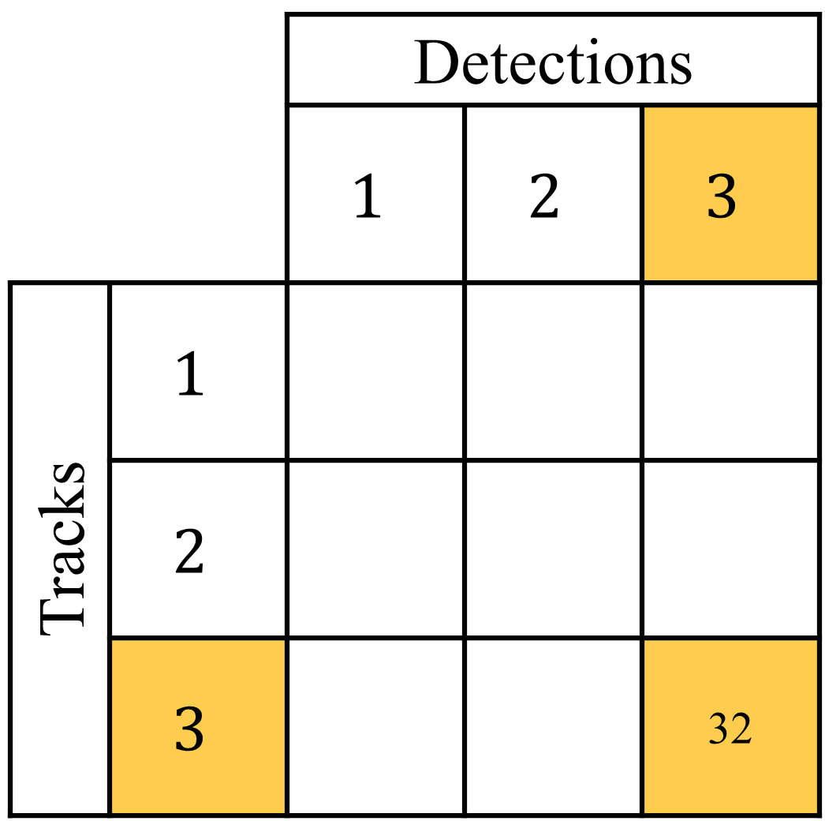
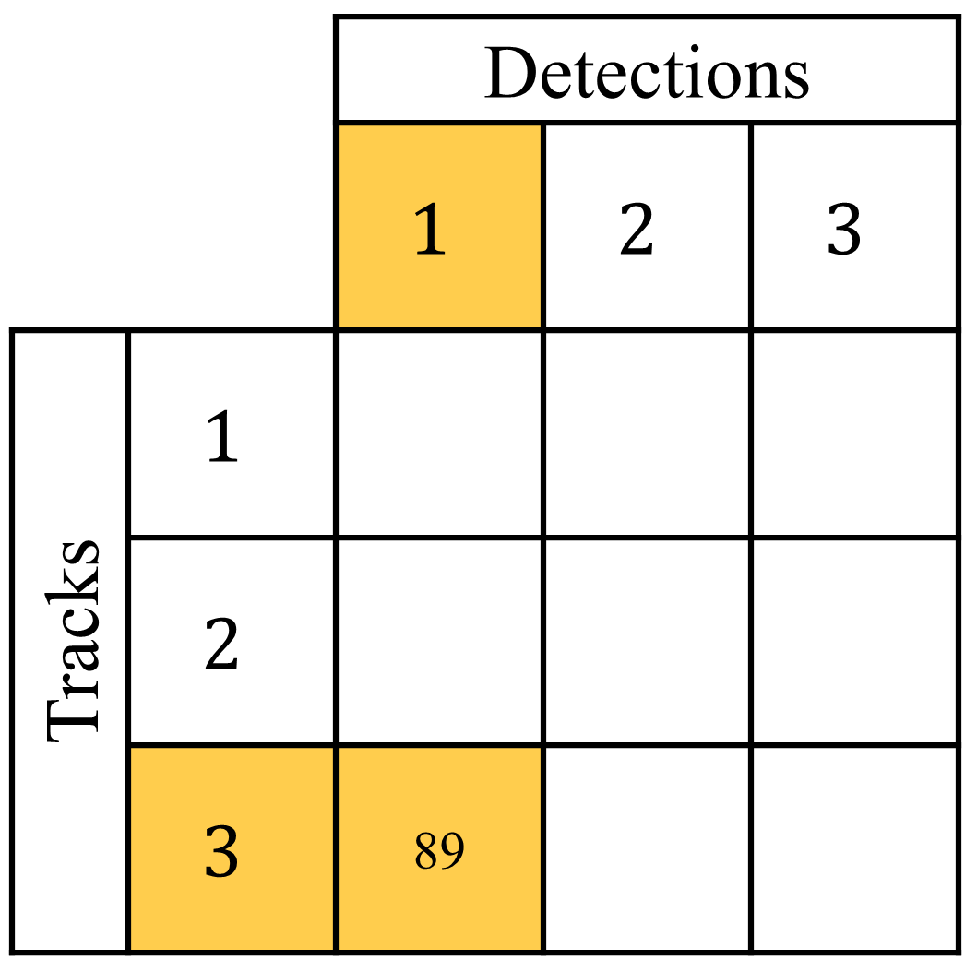
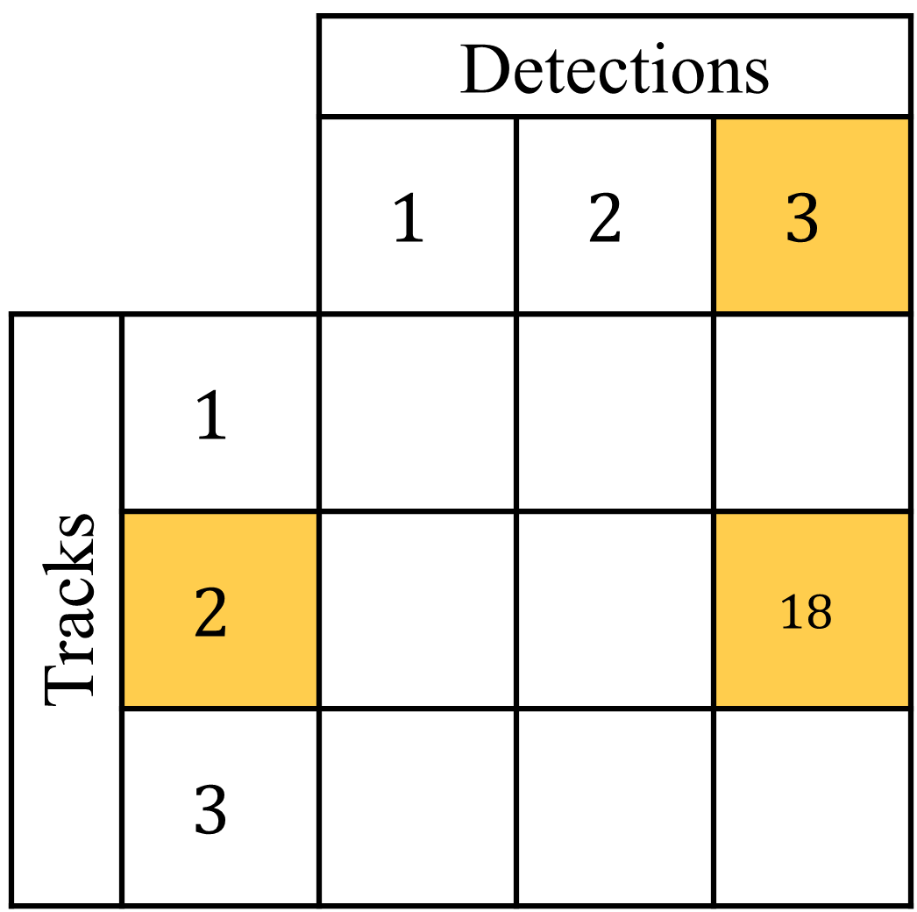
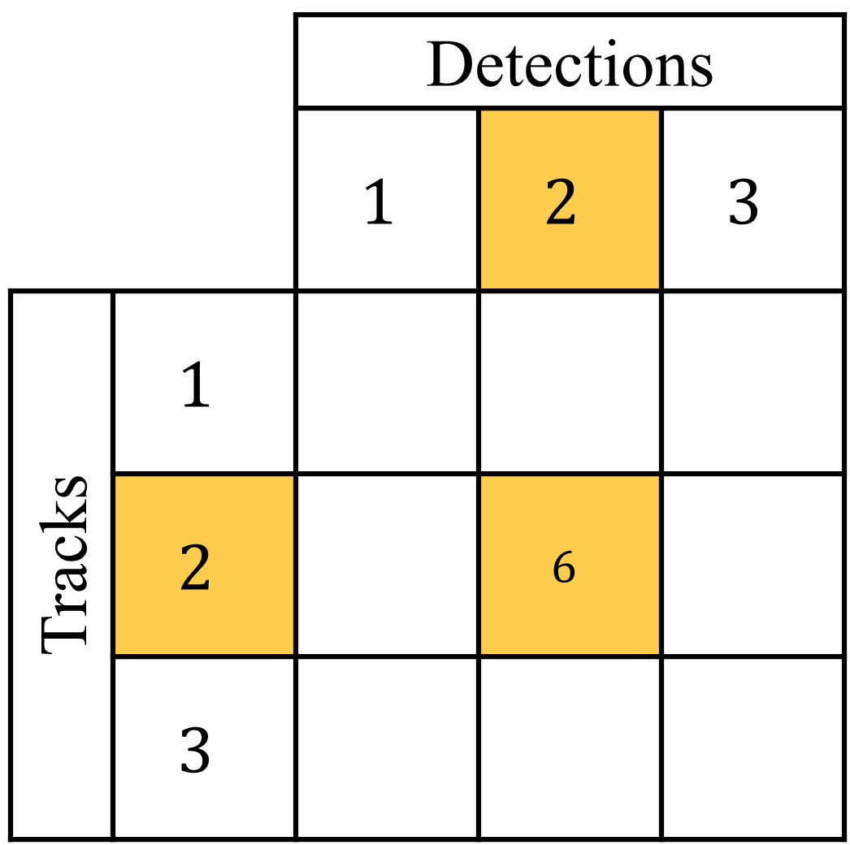
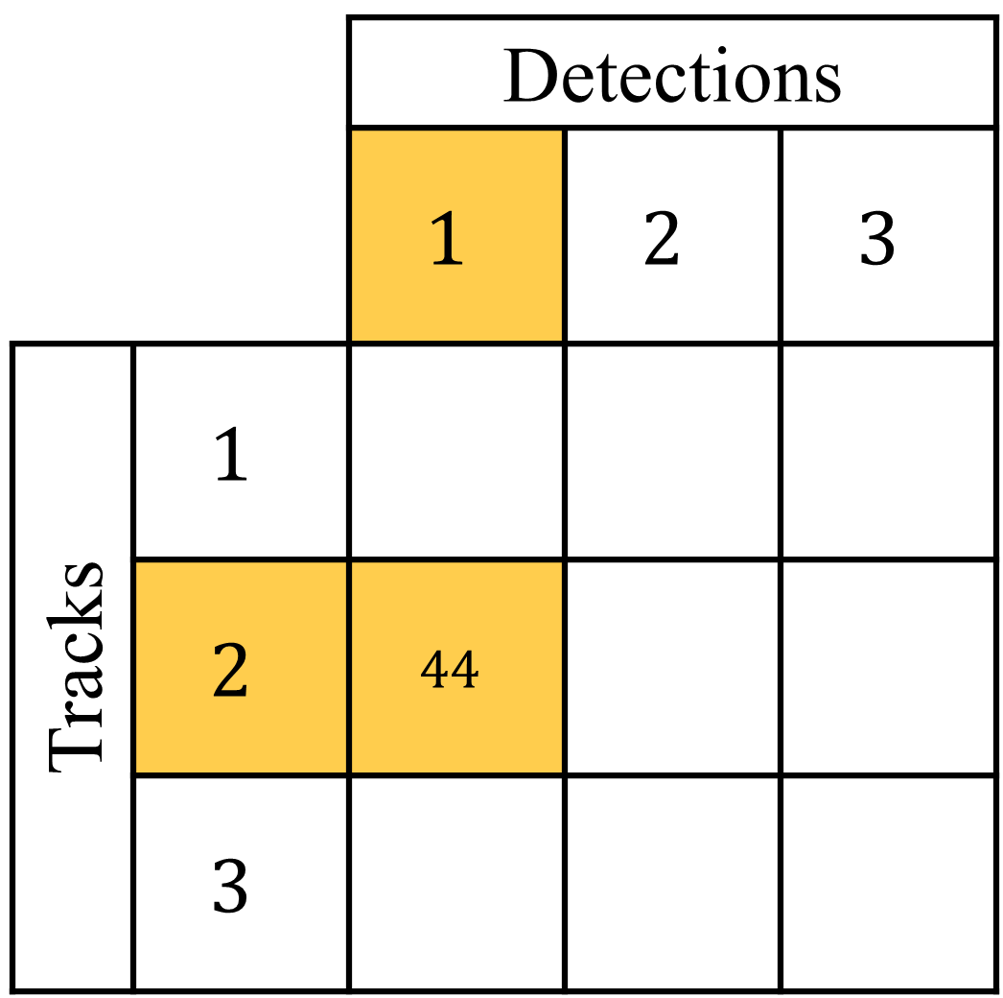
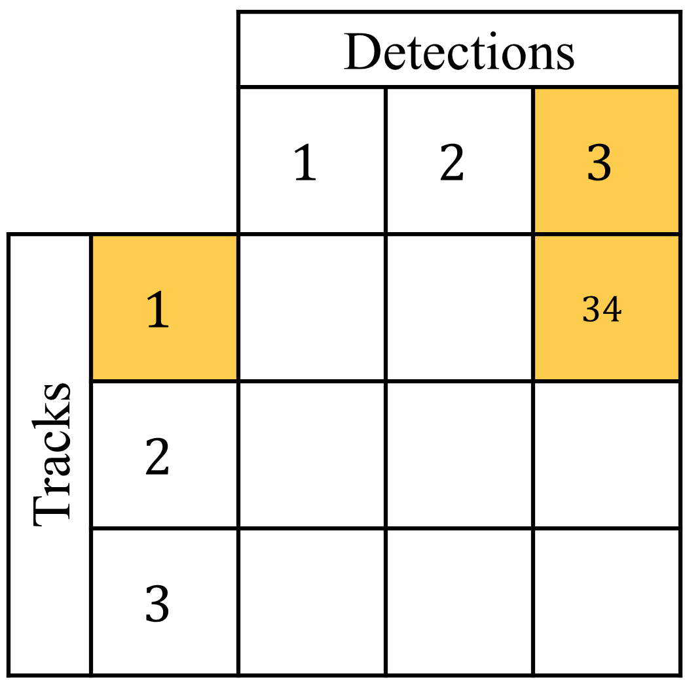
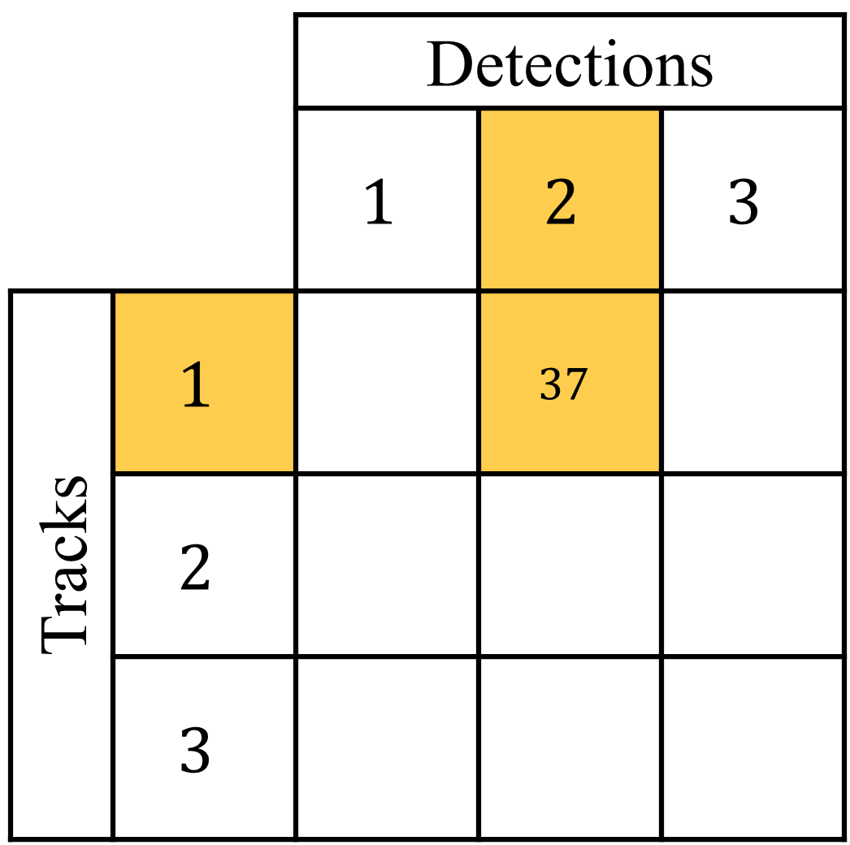
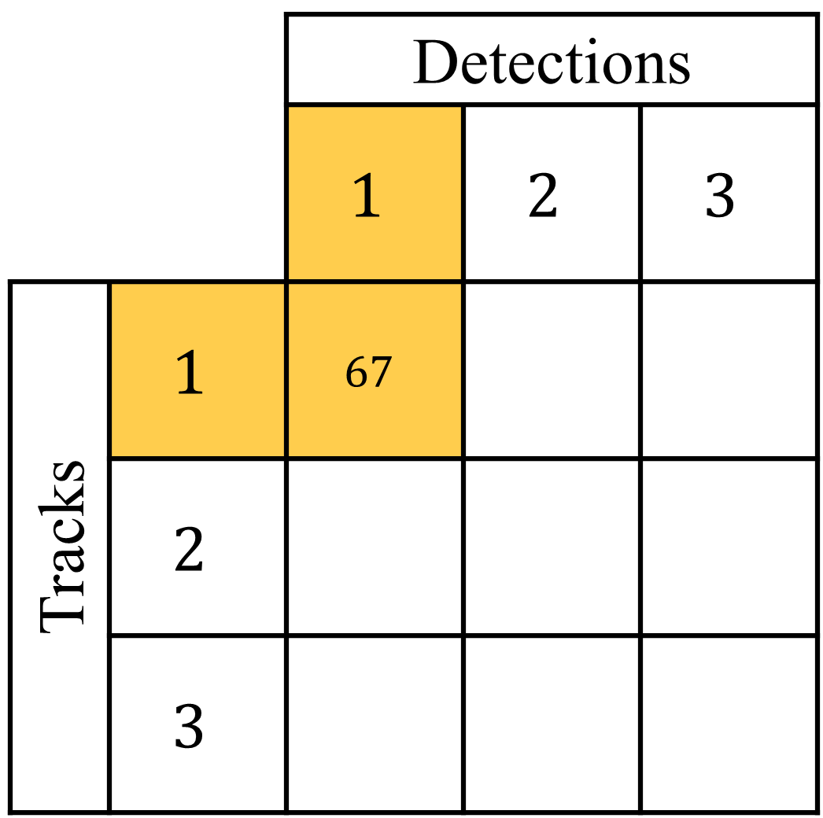
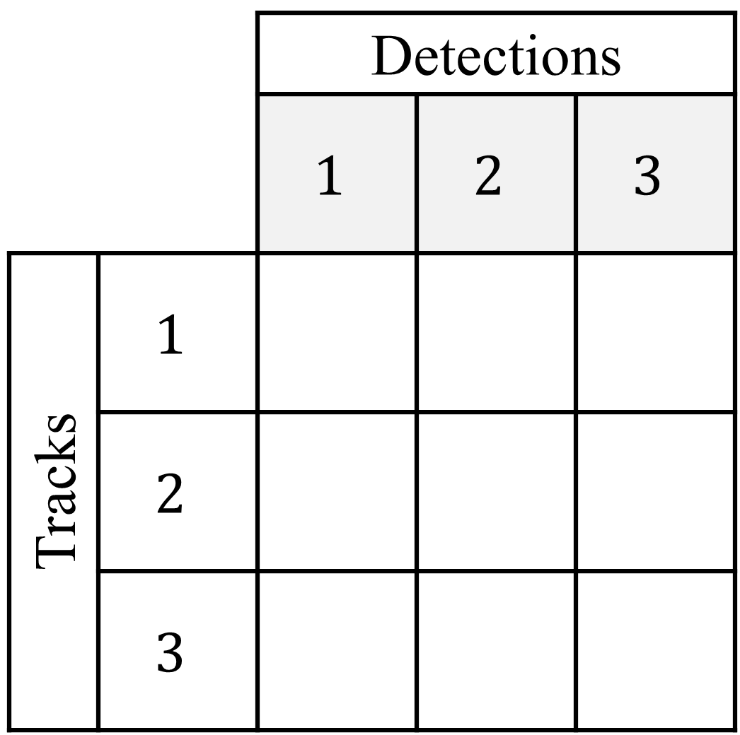

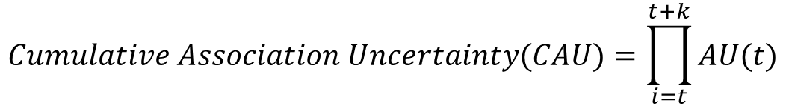
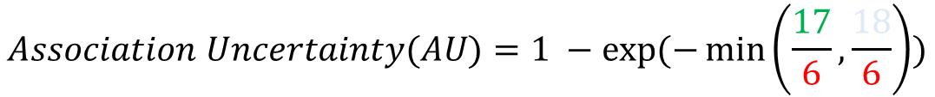
Method – Incorporating Uncertainty
$$Association Uncertainty(AU)=1 −exp⁡(−\min\left(\frac{17}{6},\frac{18}{6}\right))$$
$$Cumulative Association Uncertainty(CAU)=\prod_{i=t}^{t+k}{AU(t)}$$
$$weighted loss=loss×CAU(t,t+k)$$
Notes:
However, if the estimated detections and associations are incorrect, the learned embeddings might be inferior. We then propose to estimate uncertainties during matching, which are further used to downweight potentially incorrect associations.
Given a set of previous tracks in frame t-1, and detections in frame t, we need to first associate each track with a detection. The Mahalanobis distance is computed for every possible association pair. The detection that corresponds to the smallest Mahalanobis distance is greedily associated with the respective track. To calculate the uncertainty, we first find the most likely alternative detection with respect to associated track. Similarly, we find the most likely alternative track with respect to associated detection. The minimum ratio of these two distances to the associated distance is used to calculate the association uncertainty. Intuitively, the uncertainty compares the distance of associated pairs with the lowest un-associated distance if we were to choose a different track or detection.
Then we multiply the uncertainties between successive frames to get the cumulative association uncertainty across frames t and t+k, which is further used to weight the loss.

Slide 15

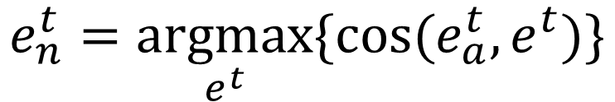






Method – Hard Negative Mining
$$e_{a}^{t}$$
$$e^{t}$$
$$e^{t}$$
$$e^{t}$$
$$0.4$$
$$0.6$$
$$e_{n}^{t}=\underset{e^{t}}{argmax}{\{cos⁡(e_{a}^{t},e^{t})\}}$$
$$0.3$$
Notes:
We use hard negative mining to select the negative example in our triplet loss. Specifically, given an anchor embedding e_a in frame t, we compute the cosine similarity between e_a and all other embeddings in frame t. We choose the detection that has the highest cosine similarity with e_a as the hardest negative example. Since this detection is in the same frame as the anchor detection, it is guaranteed to be a different object.

Slide 16
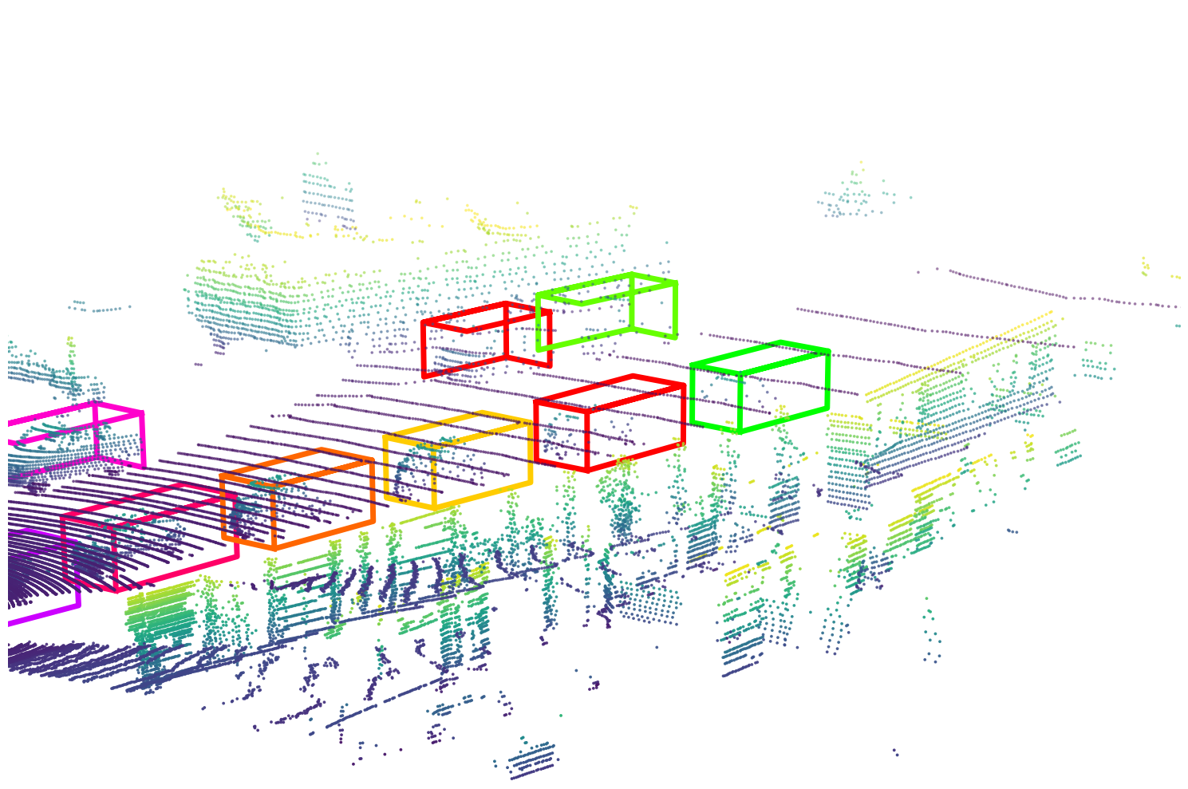
Test Time
Multi-Object Tracking
t
t + k
Logistic regression combining:
Motion (M), Detection (D), Appearance (A)
Notes:
At test time, self-supervised embeddings are extracted from each candidate detection in a frame. We use cosine similarity of embeddings extracted from each pair of objects to represent their appearance similarity.
To perform multi-object tracking, we use a linear combination of motion information/ detection confidence / appearance similarity as the association score. The coefficients of the linear function are estimated via logistic regression which classifies whether a detection belongs to a track.

Slide 17
Experiment Setups
Single Object Tracking
Multi-Object Tracking
Embedding train with NuScenes[1]
Logistic regression train with NuScenes[1]
Evaluate with NuScenes[1]
Evaluation Metric: AMOTA
Embedding train with NuScenes[1]
Evaluate with KITTI[2]
Evaluation Metric: Classification Accuracy
[1] Caesar, Holger et al. “nuScenes: A multimodal dataset for autonomous driving.”, CVPR2020
[2] Geiger, Andreas et al. “Vision meets Robotics: The KITTI Dataset.”, IJRR2013
Notes:
We evaluate our method under two experiment setups: single object tracking and multi-object tracking. For single object tracking we only use the appearance similarity in order to isolate the benefit of our self-supervised embedding. We calculate the classification accuracy on KITTI using the embeddings trained with NuScenes. We also evaluate the performance of our proposed multi-object tracker using AMOTA on NuScenes dataset.

Slide 18
Experiments – Single Object Tracking
Supervised
Self-supervised
[1] Chang, Angel, et al. “ShapeNet: An Information-Rich 3D Model Repository”, arXiv
[2] Giancola, Silvio, et al. “Leveraging Shape Completion for 3D Siamese Tracking.”, CVPR2019
Notes:
For single object tracking, we compare our method with two random baselines for sanity check: we randomly pick one of the candidate ground-truth detection at each time step. An accuracy of about 25% suggests that there are four candidates on an average per frame. For randomly initialized network embedding, we randomly initialize the weights of the PointNet architecture.
We also compare our method with two supervised baselines: Pointnet trained with ShapeNet classification and Shapecompletion3DTracking.
As shown in the chart, our method, trained on unlabeled data, outperforms all these baselines. The method of ShapeCompletion3DTracking has performance near to that of our method; however their approach was trained on fully supervised data with ground-truth detections and ground-truth data associations. On the other hand, our method was trained on unlabeled data with estimated detections and estimated data associations, using uncertainty-weighting and hard negative mining.
To provide an upper bound on our performance, we also compare against using full supervision, which is trained with ground-truth detections and ground-truth associations. This is the ideal case for self-supervised learning and achieves the oracle performance of our method. As shown in the chart, the performance of our proposed method is very close to the oracle. However, because our method can be used to train an embedding on an unlabeled dataset, we could potentially obtain even better performance given a larger unlabeled dataset on which to train our method.

Slide 19
Experiments – Multi-object Tracking
Notes:
We perform an ablation to show the contribution of the different components of our association score: the motion score, the detection score, and the appearance score. The results show that each component is important for accurate association.

Slide 20
Experiments – Ablations
Notes:
We perform another ablation analysis to quantify the performance of each component of our system. We remove one component of our training procedure at a time. We note that either removing hard negative mining, or not incorporating uncertainty, consistently reduces performance. This shows that both these components are useful for our method.

Slide 21
Experiments – Uncertainty
Notes:
We also verify the effectiveness of our proposed method for estimating association uncertainty. We can see that incorrect association are with lower association score if the appearance embedding is trained with uncertainty weighting and correct associations are with higher association score if the appearance embedding is trained with uncertainty weighting.
This result indicates that incorporating uncertainty is useful for suppressing the contribution of incorrect associations during self-supervised training.

Slide 22
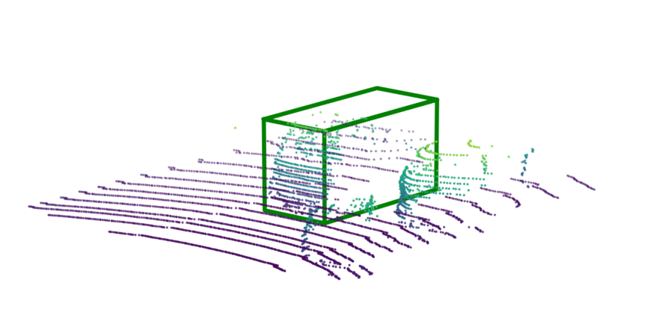
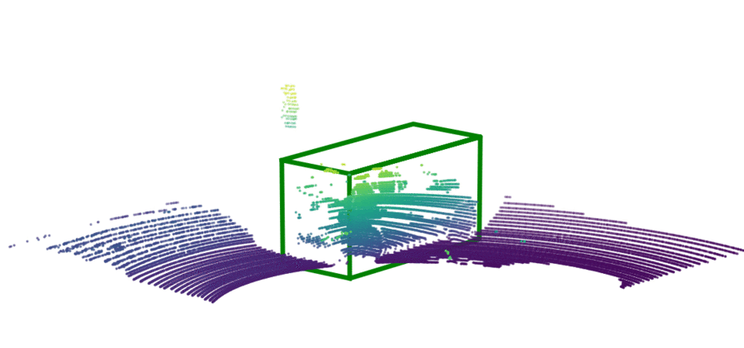
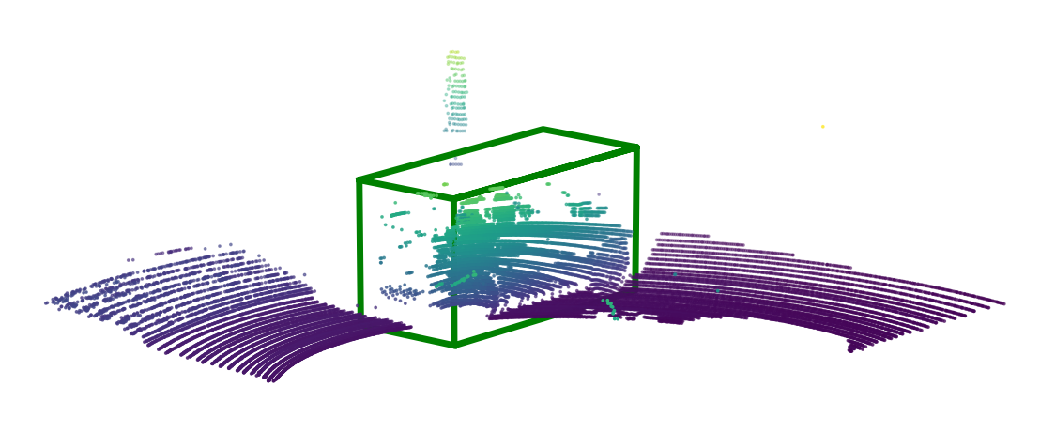
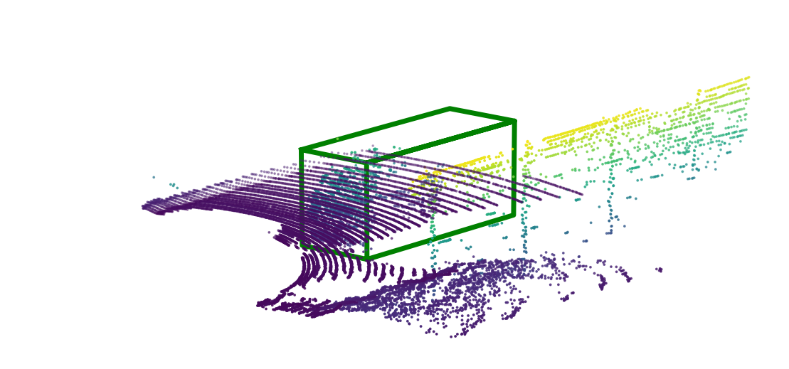
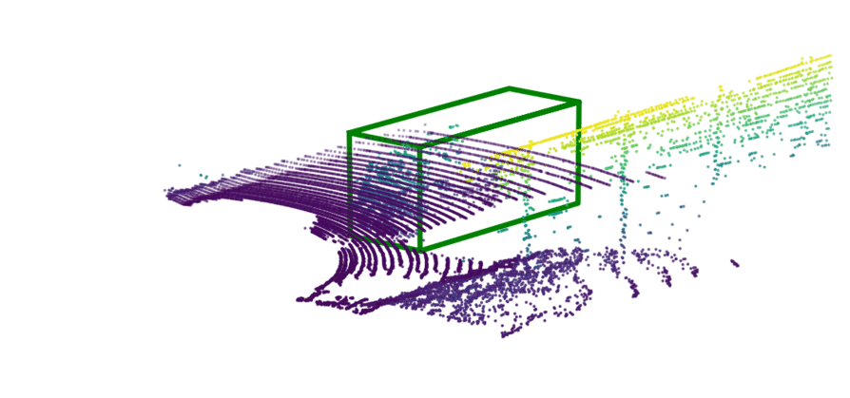
Experiments – Qualitative
Tracked Object
Ours
ShapeNet
Notes:
We also compare our self-supervised embedding with baseline ShapeNet embedding qualitatively. The first column shows the exemplar anchor box. This denotes the car that is to be tracked. The middle column shows the bounding box selected by our method at each time step. The right column shows bounding boxes that the ShapeNet embedding deems to be more similar to the tracked object. These examples show that the embedding learned using a triplet loss via self-supervision is able to correctly match point clouds of the same object even if the distractor object's point cloud is only subtly different.

Slide 23
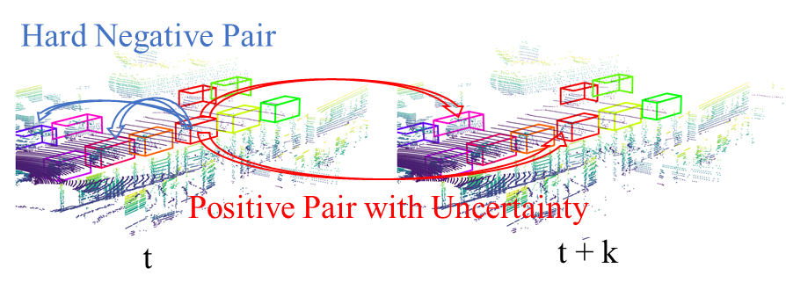

Conclusion
Self-supervised representation learning method for 3D tracking and data association
We incorporate tracking uncertainty for robust self-supervised learning to handle tracking errors
Avoids the need for extensive manual annotation; our self-supervised learning approach can make use of large unlabeled datasets
Project Page
Notes:
Please check our paper and project page for more details.

