Slide 1
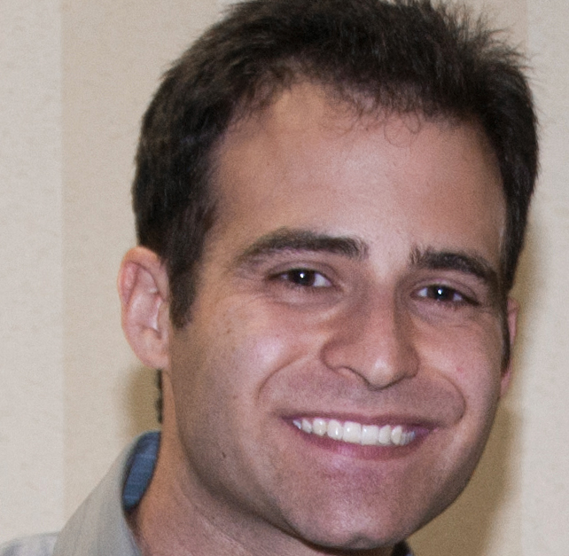
Semi-supervised 3D Object Detection via Temporal Graph Neural Networks
¹CMU RI
²Honda Research Institute
³CMU MLD
⁴National Chiao Tung University
Jianren Wang¹
Yi-Ting Chen⁴
David Held¹
Jianren Wang¹
Haiming Gang²
Siddharth Ancha³
Notes:
Hello Everyone, I am Jianren Wang from CMU. Today I am going to talk about “Semi-supervised 3D Object Detection via Temporal Graph Neural Networks”. This is joint work with Haiming, Sid, Yi-Ting and David Held.

Slide 2
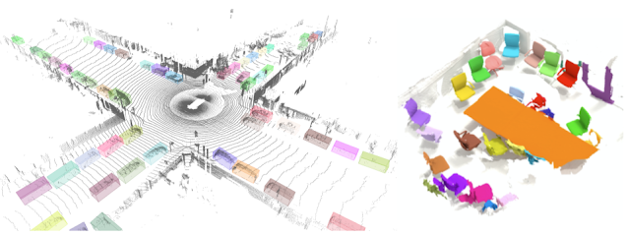
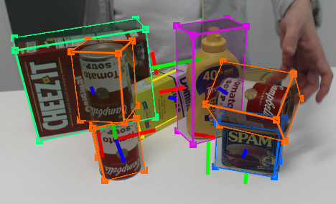
3D Object Detection
Fundamental In:
Autonomous Driving
Manipulation
AR/VR
Notes:
In this work, we focus on 3D object detection, which is an essential and fundamental problem in autonomous driving, object manipulation and augmented reality. In recent years, many approaches have emerged and achieve high performances on various benchmark datasets.

Slide 3
3D Object Detection
However
· Supervised -> Large amount of annotation
· Labeled 3D annotations -> Difficult and time consuming
Notes:
Despite the impressive performances, most of the existing approaches are strongly supervised and require the availability of a large amount of well-annotated 3D data. Labeled 3D annotations are always time-consuming and expensive to collect

Slide 4
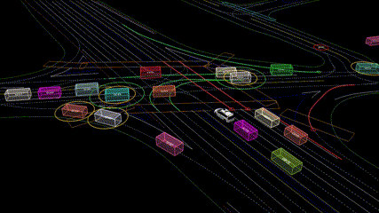
3D Object Detection
On the other hand
· Point Cloud Videos -> Cheaply Available
· Point Cloud Videos -> Contains richer spatiotemporal information
Notes:
On the other hand, in most applications, point clouds are recorded over time as a data stream. A point cloud video contains richer spatio temporal information than a single frame.

Slide 5
3D Object Detection
Point Cloud Videos
· False Negative
· False Positive
· Misalignment
· Can we utilize this information to improve a single frame 3D object detector?
Yes, Semi-supervised training!
Notes:
For example, a false negative (missing) detection can be identified if the same object is detected in adjacent frames but is missing in the current frame. A false positive detection can be identified if the detection is isolated i.e. a corresponding detection occurs neither in the previous nor the subsequent frame. A misalignment can be identified if the alignment differs significantly between successive video frames. Can we utilize these information to improve a single frame 3D object detector?

Slide 6
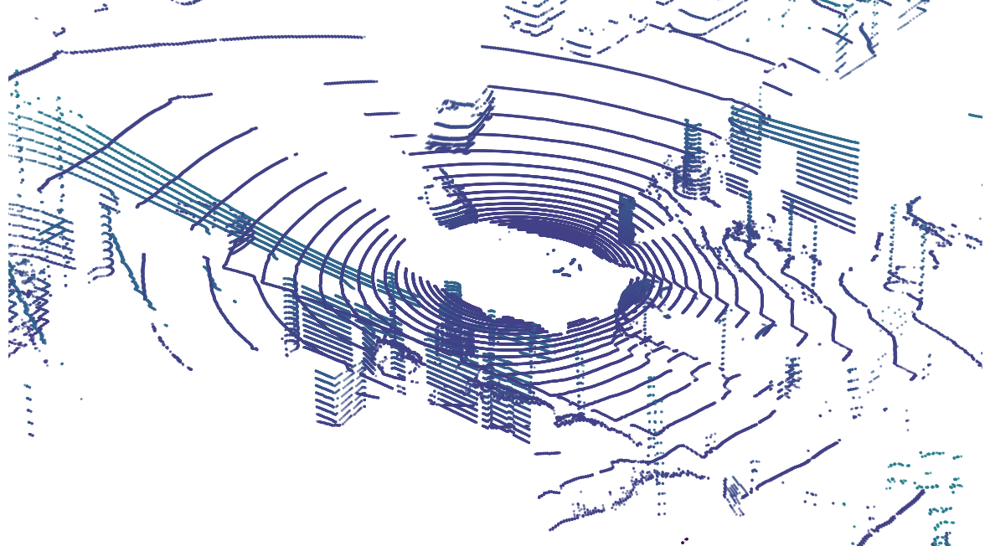
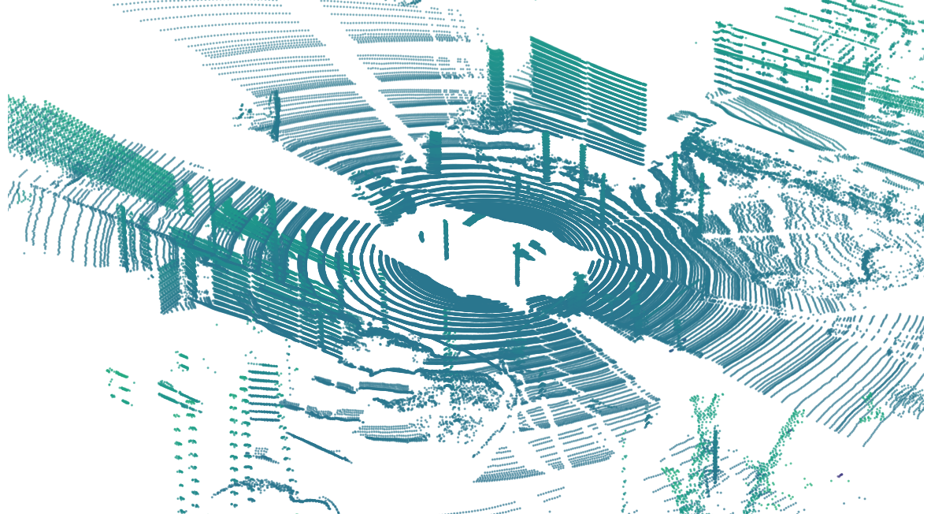
Method: Overview
$$t−1$$
$$t$$
$$t+1$$
Notes:
Here is an overview of our proposed method.

Slide 7
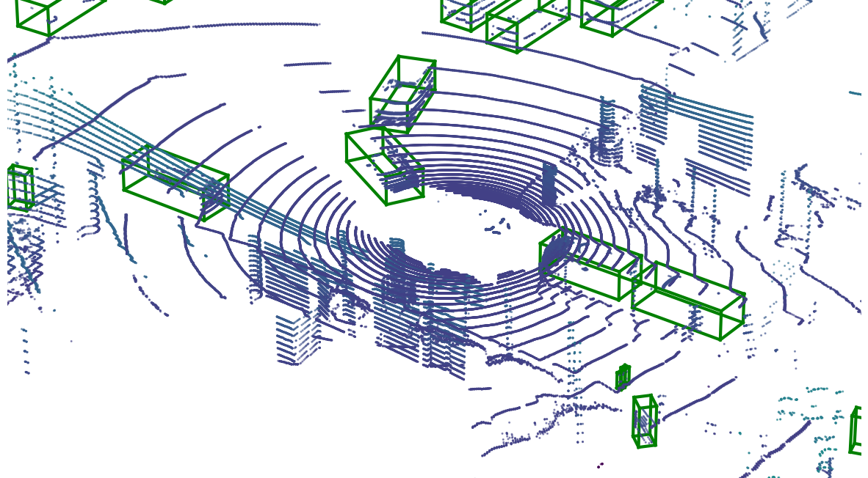
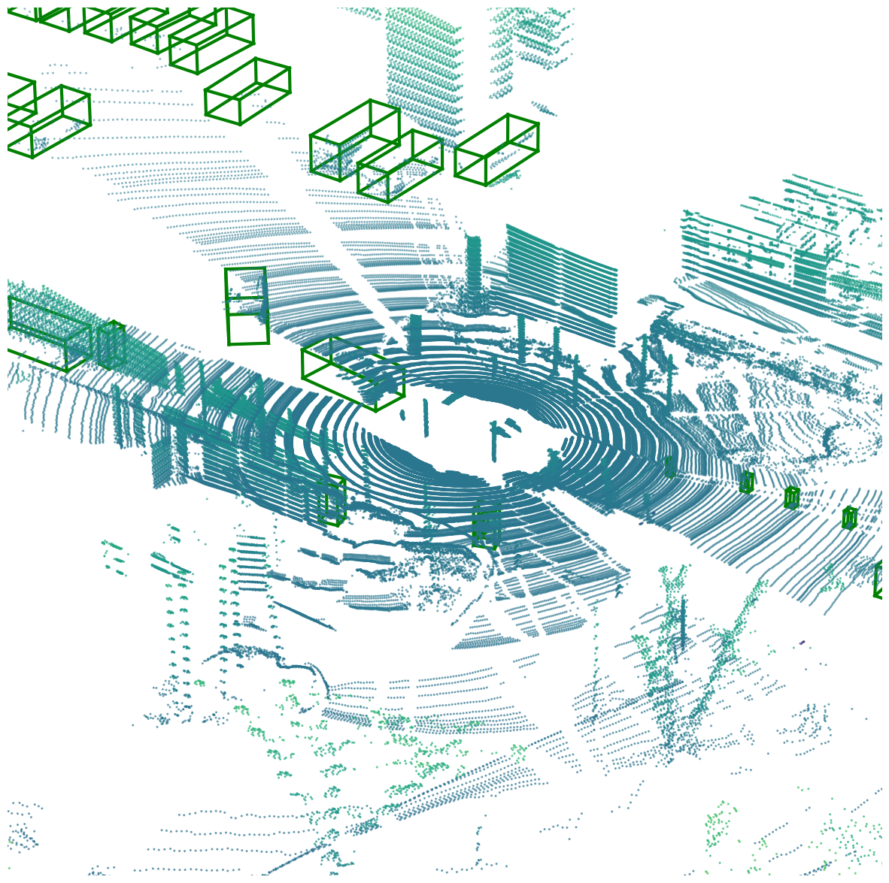
Method: Overview
Detector
Detector
Detector
$$t−1$$
$$t$$
$$t+1$$
Notes:
Given a pretrained 3D object detector

Slide 8
Method: Overview
Spatiotemporal Reasoning
Teacher
Detector
Detector
Detector
$$t−1$$
$$t$$
$$t+1$$
Notes:
Our method consists of a teacher which performs spatiotemporal reasoning for 3D object detection

Slide 9
Method: Overview
Pseudo Label
Spatiotemporal Reasoning
Teacher
Uncertainty-aware Semi-supervised Training
Detector
Detector
Detector
Detector
Student
$$t−1$$
$$t$$
$$t+1$$
Notes:
This teacher is then used to provide pseudo labels to train a student which takes as input only a single frame. We use uncertainty-aware training to handle incorrect pseudo labels produced by the teacher.

Slide 10
Method: Overview
Pseudo Label
Spatiotemporal Reasoning
Teacher
Detector
Detector
Detector
Detector
Student
$$t−1$$
$$t$$
$$t+1$$
Update the teacher detector
Notes:
The detector is then updated to provide better detection candidates. The teacher and student can be updated alternatively to keep improving the performance.

Slide 11
Teacher Network: Temporal Graph Neural Networks
🗸
🗸
🗸
Refined Detection Score
🗸
🗸
🗸
✘
Temporal Graph Neural Network
(Spatiotemporal Reasoning)
3D Object Detection Module
$$…$$
$$…$$
$$t−1$$
$$t$$
$$t+1$$
Notes:
Our teacher network consists of two modules: a 3D object detection module, and a spatiotemporal reasoning module. The 3D object detection module can be any existing 3D object detector, which is initially trained from only a limited amount of labeled data. We then input each frame to the 3D object detector to find detected objects in the scene. To smooth these detections and create more accurate pseudo labels, we propose a novel spatiotemporal reasoning module: we build a video graph over the frames of the 3D video (sequence of point clouds) and use a Graph Neural Network (GNN) to output new scores for each detection node based on the principle of spatiotemporal consistency. This spatiotemporal reasoning module is trained on the same labeled data as the 3D object detection module.

Slide 12
Teacher Network: Temporal Graph Neural Networks
🗸
🗸
🗸
Refined Detection Score
🗸
🗸
🗸
✘
Temporal Graph Neural Network
(Spatiotemporal Reasoning)
3D Object Detection Module
$$…$$
$$…$$
$$t−1$$
$$t$$
$$t+1$$
Node Feature: detection score; #points in the detection box; size of the detection box
Edge Feature: center distance between each pair of boxes; size difference; orientation difference
Notes:
We extract a set of high-level features of each candidate detection as node features, including detection score; #points in the detection box; size of the detection box
Each node is connected to neighboring nodes within the neighboring frames. We also add the edge features, including center distance between each pair of boxes; the difference in the sizes along each dimension and the difference in bounding box orientation.

Slide 13
Method: Overview
Pseudo Label
Spatiotemporal Reasoning
Teacher
Detector
Detector
Detector
Detector
Student
$$t−1$$
$$t$$
$$t+1$$
Update the teacher detector
(Exponential moving average)
Notes:
The teacher’s detector is updated as an exponential moving average of the student to provide better pseudo labels.

Slide 14
Teacher Network: Graph Augmentation
· Copy-and-Paste
· Random Trim
· Random Noise
Notes:
To prevent the graph neural network from overfitting,we use data augmentation.
We propose trajectory-level copy and paste. We first assign each object an identity based on the its center distance to the closest ground truth object. Then, detections with same identity form a trajectory; Similarly, we also randomly remove trajectories from current video as a form of data augmentation.
To further increase the diversity of our data, we propose to randomly select the first frame and the last frame from a video to form the sequence of frames used in the graph.
We also propose to add random noise to the location, size, orientation and detection scores of individual detections. This is to simulate errors of a pre-trained object detector on more diverse unlabeled data.

Slide 15
Calibrate teacher’s prediction – isotonic regression [1]
% True Positive
% True Positive
Prediction Score
Prediction Score
[1] Zaadrozny, Bianca et al. “Obtaining calibratedprobability estimates from decision trees and naive bayesianclassifiers.”, ICML 2001
Notes:
One of the most prominent challenges in training on pseudo labels is that they are not guaranteed to be accurate. Our solution is to leverage uncertainty in the pseudo labels. For examples with high uncertainty, we discount the contribution of the corresponding example during training. This is intended to reduce the effect of incorrect labels in semi-supervised training.
We first calibrate the pseudo label so that the probability associated with the predicted label reflects its ground truth correctness likelihood.

Slide 16
Uncertainty-weighting
· Uncertainty-weighting Loss
$$u=−s log\left(s\right)−\left(1−s\right) log⁡(1−s)$$
$$u:uncertainty$$
$$s:calibrated teacher^{′}s prediction$$
$$l=\left\{\begin{aligned}−{\left(1−u\right)}^{k}\log\left(p\right), if s≥0.5 \\ −{\left(1−u\right)}^{k}\log\left(1−p\right), if s<0.5\end{aligned}\right.$$
$$p:student′s prediction$$
$$k:focusing parameter$$
Notes:
We then use the entropy of the calibrated score s as a measure of uncertainty u.
This uncertainty is then used to weight the pseudo labels during training the student.
k is the focusing parameter k≥0 which helps the model focuses on the samples with low uncertainty and p is the prediction of our student neural network.

Slide 17
Gradually Semi-supervised Training
Iteration 1
Iteration 2
Iteration 3
Labeled Data
Unlabeled Data
Notes:
To avoid the student learning from large amount of un-reliable pseudo labels, we propose gradual semi-supervised training. In a nutshell, the student is training with a mix of labelled and unlabeled data, while the amount of unlabeled data increase gradually in each iteration.

Slide 18
Experiment Setups
Train:
3D object detector pre-trained with 50 scenes on nuScenes [1] train
500 scenes from nuScenes train for Semi-Supervised Training
150 scenes from nuScenes train as validation set (not overlapping with the 500 scenes for semi-supervised training)
Test:
150 scenes from nuScenes validation as test set
Metric: mAP
[1] Caesar, Holger et al. “nuScenes: A multimodal dataset for autonomous driving.”, CVPR2020

Slide 19
Results: Baselines
[1] Teichman, Alex et al. “Tracking-based semi-supervised learning.”, IJRR2012
[2] Zhao, Na et al. “Sess: Self-ensembling semi-supervised 3d object detection.”, CVPR2020

Slide 20
Results: Ablation
Notes:
Instead of using our proposed temporal graph neural networks, we adopt a 3D multi-object tracker to reason about the spatial-temporal information. This shows the effectiveness of our proposed temporal gnn.
Without iteratively training the student and the teacher, our method depreciates a lot since the teacher is not improved.
We also show uncertainty-weight is important to our method as it prevents the student to learn from incorrect pseudo labels.
Finally, we show the efficacy of our proposed data augmentation to prevent the temporal gnn from overfitting.

Slide 21
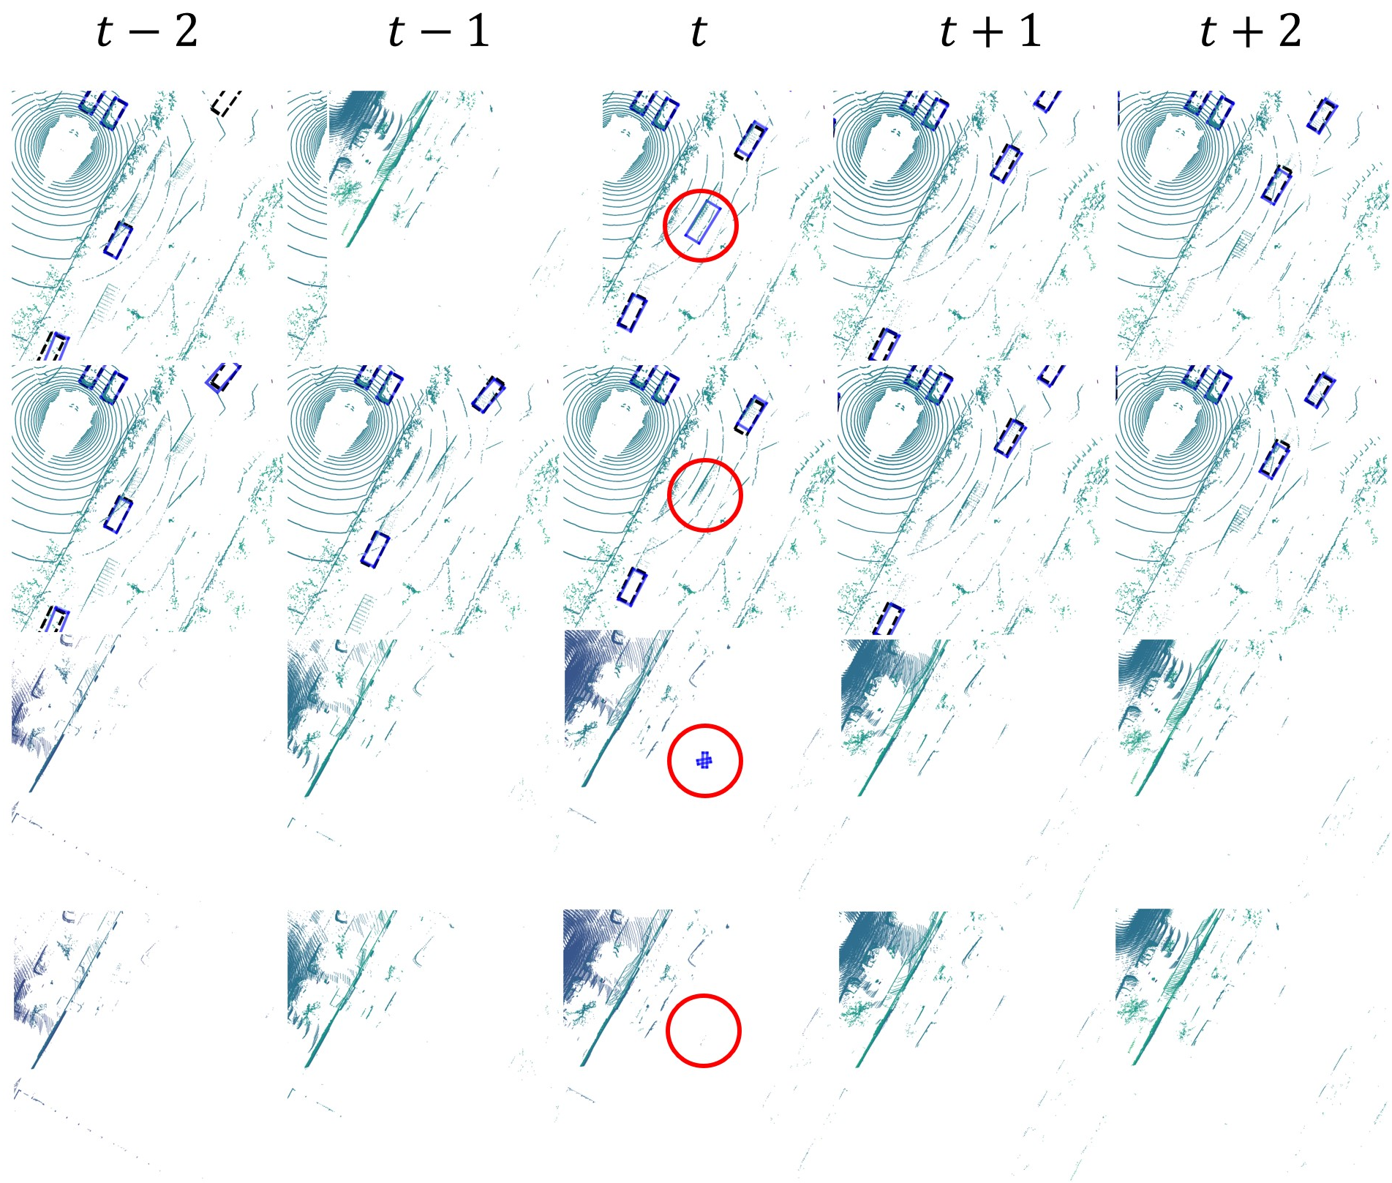
Results: Qualitative
Student
Ours
Student
Ours
Correct False Positive
Notes:
Here we show our method successfully correct the false positive.

Slide 22
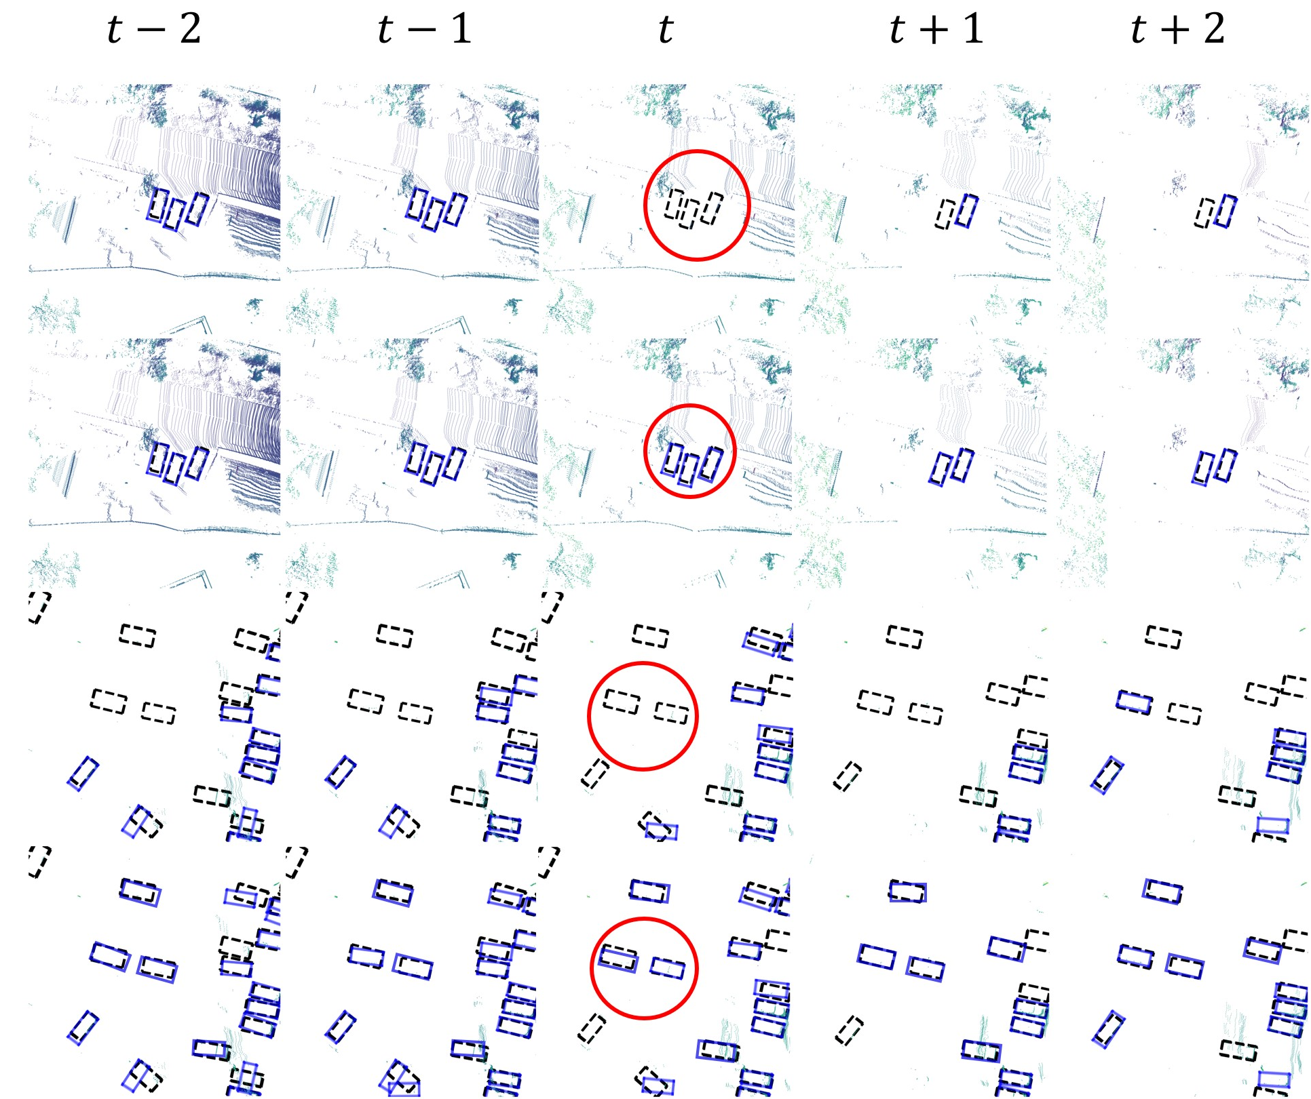
Results: Qualitative
Student
Ours
Student
Ours
Correct False Negative
Notes:
Here we show our method successfully correct the false negative.

Slide 23
Conclusion
We propose to leverage unlabeled point cloud videos by semi-supervised learning.
Our method incorporates uncertainty-aware semi-supervised training with a GNN for spatiotemporal reasoning
Our method achieves state-of-the-art detection performance on the challenging nuScenes and H3D benchmarks
Our method removes the need for excessive efforts in data annotation
Pseudo Labeled Data
$${(x}_{u},\hat{y_{u}})$$
Temporal GNN
Detector
Better Candidates

Slide 24
Acknowledgements
Notes:
The work is sponsored by Honda Research Institute & National Science Foundation.

Slide 25
Thank you
Conclusion
We propose to leverage unlabeled point cloud videos by semi-supervised learning.
Our method incorporates uncertainty-aware semi-supervised training with a GNN for spatiotemporal reasoning
Our method achieves state-of-the-art detection performance on the challenging nuScenes and H3D benchmarks
Our method removes the need for excessive efforts in data annotation
Pseudo Labeled Data
$${(x}_{u},\hat{y_{u}})$$
Temporal GNN
Detector
Better Candidates

