Slide 1
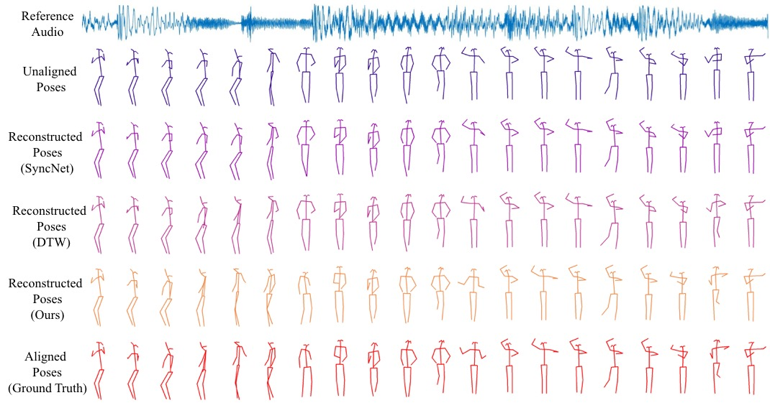
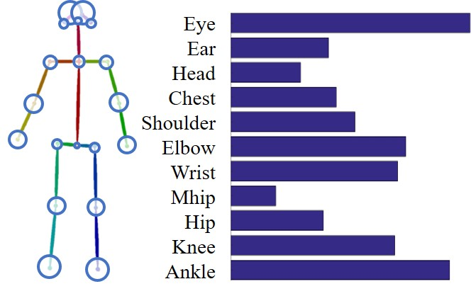
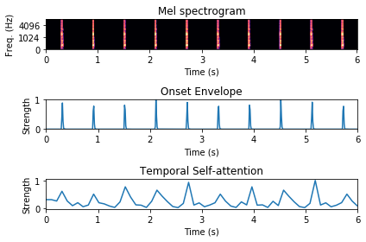
AlignNet: A Unifying Approach to Audio-Visual Alignment Jianren Wang^{1*}, Zhaoyuan Fang^{2*}, Hang Zhao³ * Equal contribution ¹Carnegie Mellon University, ²University of Notre Dame, ³MIT CSAIL
Introduction
Dancers move their bodies with music, speakers talk with lip motions and are often accompanied by hand and arm gestures. The synchrony between visual dynamics and audio rhythms poses perfect performances.
However, recorded videos and audios are not always temporally aligned. e.g. dancers may not be experienced enough to follow the music beats precisely. This alignment problem is especially difficult for humans since the misalignment is often non-uniform and irregular.
In this work, we present AlignNet, a model that synchronizes videos with reference audios under non-uniform and irregular mis-alignments..
Spatial and Temporal Attention Modules
Multimodal Feature Pyramid Extraction
Time Warping
Affinity Funtion
Multimodal Dense Correspondence Estimation
Experiments
Reconstruction
AFE: Average difference between the reconstructed frame indices and the original undistorted frame indices
Accuracy: The percentage of frames in the aligned signal which do not lag by more than 125 ms or lead by more than 45 ms.
Retargeting (We ask which video aligns better to the audio.)
 | Performance
 | Music-dance alignment |  | Speech-lip alignment
 | AFE | Accuracy | AFE | Accuracy
SyncNet | 6.58 | 25.88 | 6.33 | 27.41
SyncNet + DTW | 4.27 | 38.29 | 3.96 | 35.94
AlignNet | 0.94 | 89.60 | 1.03 | 81.05
Dance50
50 hours of dancing clips from over 200 dancers
K-pop dance from Youtube / Bilibili
30 FPS / 44100 Hz
Single-person, No occlusion
2D keypoints annotation
Ablation Study
 | Music-dance alignment
 | AFE | Accuracy
Base | 2.87 | 43.57
FP | 2.45 | 56.88
FP + MI | 1.81 | 67.49
FP + MI + SA | 1.32 | 75.33
FP + MI + SA+TA | 1.14 | 79.65
FP + MI + SA + KA | 0.97 | 88.20
FP + MI + SA + KA + TA | 0.94 | 89.60
 | Performance
 | Music-dance | Speech-lip
Direct Comb. | 31% | 22%
AlignNet | 69% | 78%
Conclusion
In conclusion, we proposed AlignNet, an end-to-end model to address the problem of audio-video alignment at arbitrary temporal scale. The approach adopts the following principles: attention, pyramidal processing, warping, and affinity function. AlignNet establishes new state-of-the-art performance on dance-music alignment and speech-lip alignment. We hope our work can inspire more studies in video and audio synchronization under non-uniform and irregular misalignment (e.g. dancing).
Method
Video Feature
Pyramid Lv. 1
···
Video Feature
Pyramid Lv. N
Keypoint Attention
Video Frames
Pred.
$$⨂$$
Warped
Audio Feature
Warping
Upsample
Correspondence
Lv. N
Pred.
$$⨂$$
Maybe a QrCode to
the website with your code.
Refined Correspondence
Affinity
Affinity
Temporal Attention
Audio Feature
Pyramid Lv. 1
···
Audio Feature
Pyramid Lv. N
Log-mel Spectrogram

