Slide 1
AlignNet: A Unifying Approach to Audio-Visual Alignment
Jianren Wang^{1*}, Zhaoyuan Fang^{2*}, Hang Zhao³
* Indicates equal contribution
¹CMU RI
²University of Notre Dame
³MIT CSAIL

Slide 2
Motivation
Misaligned
Aligned

Slide 3
Dataset: Dance50
50 hours of dancing clips from over 200 dancers
K-pop dance from Youtube / Bilibili
30 FPS / 44100 Hz
Single-person, No occlusion
2D keypoints annotation
Public

Slide 4
Approach: Pipeline
Video Feature
Pyramid Lv. 1
Video Feature
Pyramid Lv. N
Keypoint Attention
···
Video Frames
Pred.
$$⨂$$
Warping
Upsample
Pred.
$$⨂$$
Refined Correspondence
Warped
Audio Feature
Correspondence
Lv. N
Affinity
Affinity
Temporal Attention
···
Audio Feature
Pyramid Lv. 1
Audio Feature
Pyramid Lv. N
Log-mel Spectrogram

Slide 5
Results
Reconstruction
 | Performance
 | Music-dance alignment |  | Speech-lip alignment
 | AFE | Accuracy | AFE | Accuracy
SyncNet | 6.58 | 25.88 | 6.33 | 27.41
SyncNet + DTW | 4.27 | 38.29 | 3.96 | 35.94
AlignNet | 0.94 | 89.60 | 1.03 | 81.05
AFE: Average difference between the reconstructed frame indices and the original undistorted frame indices
Accuracy: The percentage of frames in the aligned signal which do not lag by more than 125 ms or lead by more than 45 ms.
Retargeting
 | Performance
 | Music-dance | Speech-lip
Direct Comb. | 31% | 22%
AlignNet | 69% | 78%
We ask which video aligns better to the audio.

Slide 6
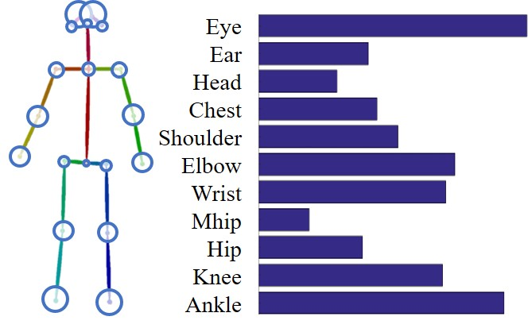
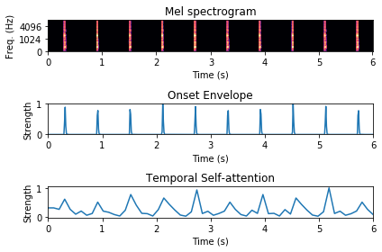
Results
Visual Attention
Audio Attention

Slide 7
Results: Ablation Study
 | Music-dance alignment
 | AFE | Accuracy
Base | 2.87 | 43.57
FP | 2.45 | 56.88
FP + MI | 1.81 | 67.49
FP + MI + SA | 1.32 | 75.33
FP + MI + SA+TA | 1.14 | 79.65
FP + MI + SA + KA | 0.97 | 88.20
FP + MI + SA + KA + TA | 0.94 | 89.60
Base (base model)
FP (feature pyramid)
MI (motion inputs, velocity and acceleration)
SA (spectrogram augmentation)
KA (keypoint attention)
TA (temporal attention)

Slide 8
Reconstruction Visualization

Slide 9
Retargeting Visualization

Slide 10
Retargeting Visualization

Slide 11
Thank you for listening!

